Slide 1
Introduction to Integrating Genomic Data
HUGEN 2073
Genomic Data Visualization and Integration
Jon Chernus

Slide 2
Agenda for second half of HUGEN 2073
Identify important repositories of information relevant to genetic and genomic research questions and describe the available data contained therein.
Annotate genes, genetic variation and genomic regions with information from such repositories using local, computational cluster and web-based software interfaces.

Slide 3
This lecture
Why should we do annotation/integration?
Overview of what kind of information is “out there”
Overview of a few databases and tools
Two examples of “input” and “output”
Some limitations

Slide 4
Association results
Everything above the dotted lines is a pineapple-on-pizza gene, right?
Your GWAS is done, and you can publish it now, right?
SNP | P
chr1:135367430 | 2.49E-01
chr1:111988570 | 1.74E-02
chr1:112070215 | 5.41E-01
chr1:112091824 | 1.04E-01
chr2:102082746 | 9.47E-01
chr2:102086444 | 4.71E-01
chr2:102118534 | 3.59E-01
chr2:102129814 | 4.93E-01
… | …
… | …
chr22:14567264 | 9.22E-03
Genome-wide meta-analysis of preference for pineapple on pizza
Notes:
Manhattan plot modified from:
https://en.wikipedia.org/wiki/Manhattan_plot#/media/File:Manhattan_Plot.png

Slide 5
Nope. But why?
What is purpose/goal of a GWAS (not just a list of p-values)?
1. GWAS
2. ???*
3. Insight into biology; new hypotheses
*The second half of this class is mostly about Step 2.

Slide 6
Association results
We can just list “the genes”, then, right?
SNP | P
chr1:135367430 | 2.49E-01
chr1:111988570 | 1.74E-02
chr1:112070215 | 5.41E-01
chr1:112091824 | 1.04E-01
chr2:102082746 | 9.47E-01
chr2:102086444 | 4.71E-01
chr2:102118534 | 3.59E-01
chr2:102129814 | 4.93E-01
… | …
… | …
chr22:14567264 | 9.22E-03
Number of rare Pokémon caught
Notes:
Manhattan plot modified from:
https://en.wikipedia.org/wiki/Manhattan_plot#/media/File:Manhattan_Plot.png

Slide 7
Not exactly. But why?
What does “the” variant do to ”the” gene? And what if…
the “signal” spans several genes?
the “signal” is between genes?
the “signal” isn’t near any genes?
Notes:
Bottom left and right – from a GWAS I ran
Top right – from https://www.biorxiv.org/content/10.1101/2020.02.28.969147v1 (see this tweet for context: https://twitter.com/Eric_Fauman/status/1233753953139032064?s=20 ; different researchers prioritized different genes in this region)

Slide 8
Linkage disequilibrium
But before even thinking about “SNP → gene/function”, we can’t just assume we know “the” SNP.
Typically there will be a number of significant SNPs at an associated locus. And those are only what you see.
Is the causal SNP (if there is one) necessarily among the tested SNPs?
Notes:
https://www.biorxiv.org/content/10.1101/815654v1.full

Slide 9
Linkage disequilibrium
Question
What is LD?
When would you say “SNP1 and SNP2 are in LD”?
Answer
LD = Association between alleles in a population
“SNP1 and SNP2 are in LD” means SNP1 and SNP2 are on the same chromosome and that their genotypes are correlated in a population
Implications
The variants you genotyped help you indirectly “tag” more the genome
So LD may help you increase chances of detecting an untested “causal” variant
Strongest-associated variant you saw may not be causal
LD → more credible set of variants, but lots of variants to sift through

Slide 10
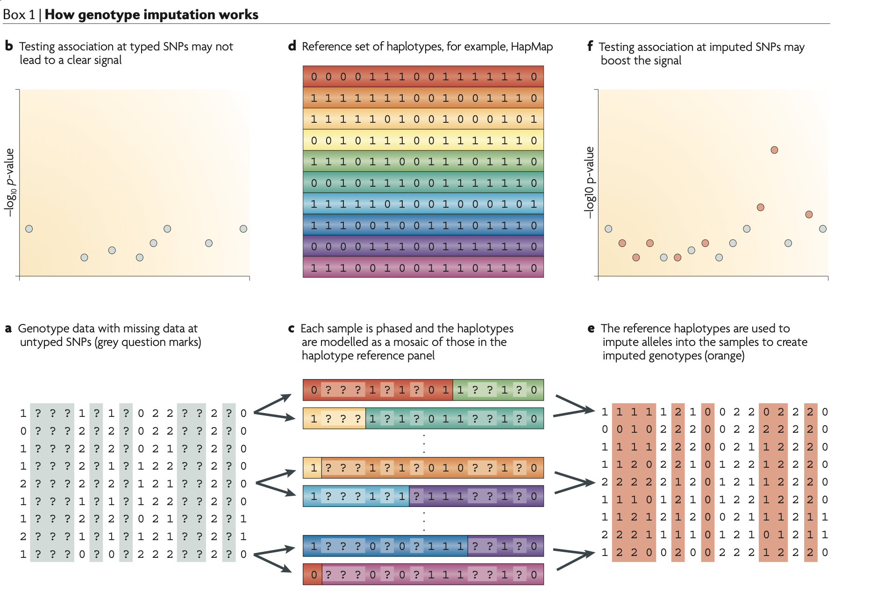
Linkage disequilibrium
Recall that LD is why imputation is possible
One way of visualizing LD
Notes:
Right image from
Marchini, J., Howie, B. Genotype imputation for genome-wide association studies. Nat Rev Genet 11, 499–511 (2010). https://doi.org/10.1038/nrg2796
Left image from
Chen, Yun & Zhao, Hua & Zhang, Yi-xin & Zuo, Peng-xiang. (2017). DCDC2 gene polymorphisms are associated with developmental dyslexia in Chinese Uyghur children. Neural Regeneration Research. 12. 10.4103/1673-5374.200809.

Slide 11
Linkage disequilibrium
Treat the set of SNPs in high LD with the lead variant together as “candidates”
The “causal” SNP may not be in your data set, but you may be detecting it indirectly

Slide 12
Some considerations so far
What SNP at this locus “matters”? (Maybe more than one! Or none.)
What gene at this locus “matters”?
Even if we somehow know the SNP/gene implicated, how can we gain biological insight?
Does the set of all associated loci (genes) tell a story?
How can an association (or set of associations) lead you to biological insights?
Can we prioritize the association results (i.e., upgrade some variants or genes as candidates)?
What kinds of information will help you answer these questions?

Slide 13
Discussion
Context 1 You have your association results: a single significant variant What information do you want about a single variant?
Context 2 You have your association results: an association “tower” including SNPs of moderate-to-high significance over a 50 kb locus What would you like to know about a locus?
Context 3 You have your association results: a set of 12 “towers” like in Context 2, scattered across the genome What are some questions you could ask about a set of loci?
Hint: what types of information might be out there?

Slide 14
Discussion - responses
Context 1 What do you want to know about a variant? | Context 2 What do you want to know about a locus? | Context 3 What do you want to know about a set of loci?
Can we categorize these types of annotation/annotation techniques?
Two big categories, with some fuzziness
Positional
Associational

Slide 15
What kind of positional information is “out there”
Is the variant of interest in a gene (or in LD with another that is)?
List of SNPs in LD (what considerations are there?)
Exon locations
Intron/splice site locations
UTR locations
Effects on amino acid sequence (missense, nonsense)
Other variant-level data
E.g., allele frequency in different populations

Slide 16
Coding Variation (Non-Synonymous)
Initiator codon
Missense
Frameshift
Stop gain
Stop loss
dbSNP 135

Slide 18
Examples of databases and tools for annotating single variants
dbSNP
gnomAD
genome browser(s)
VEP (Variant Effect Predictor)
ANNOVAR

Slide 19
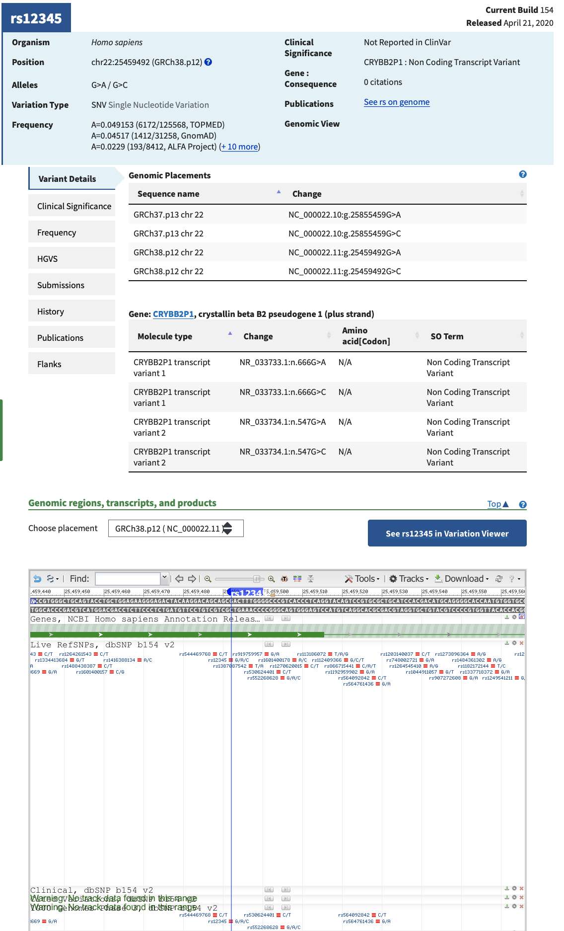
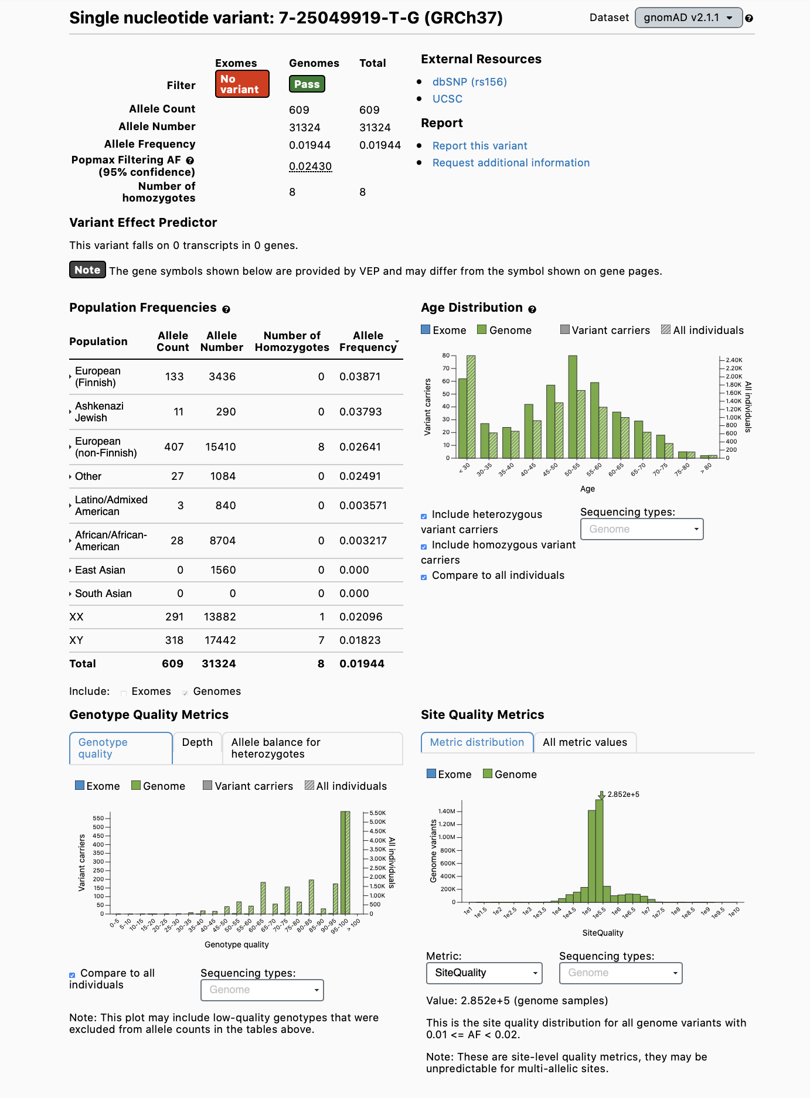
← dbSNP gnomAD →
https://www.ncbi.nlm.nih.gov/snp/
https://gnomad.broadinstitute.org

Slide 20
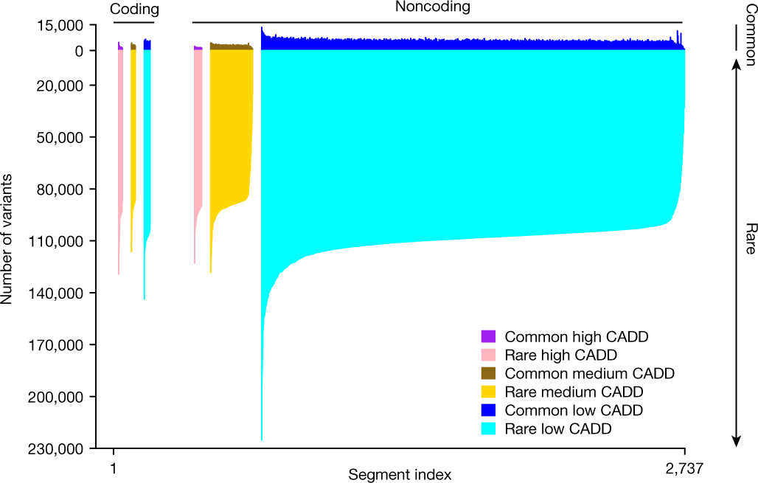
TOPMED
Notes:
Source: https://www.nature.com/articles/s41586-021-03205-y/figures/1
Common (allele frequency ≥ 0.5%) and rare (allele frequency < 0.5%) variant counts are shown above and below the x axis, respectively, within 1-Mb concatenated segments (see Methods). Segments are stratified by CADD functionality score, and sorted based on their number of rare variants according to the functionality category. There were 22 high CADD, 22 medium CADD and 34 low CADD coding segments, and 40 high CADD, 238 medium CADD and 2,381 low CADD noncoding segments. Noncoding regions of the genome with low CADD scores (<10, reflecting lower predicted function) have the largest levels of common and rare variation (noncoding plot region, dark and light blue, respectively), followed by low CADD coding regions (coding plot region, dark and light blue, respectively). Overall, the vast majority of human genomic variation comprises rare variation.

Slide 21
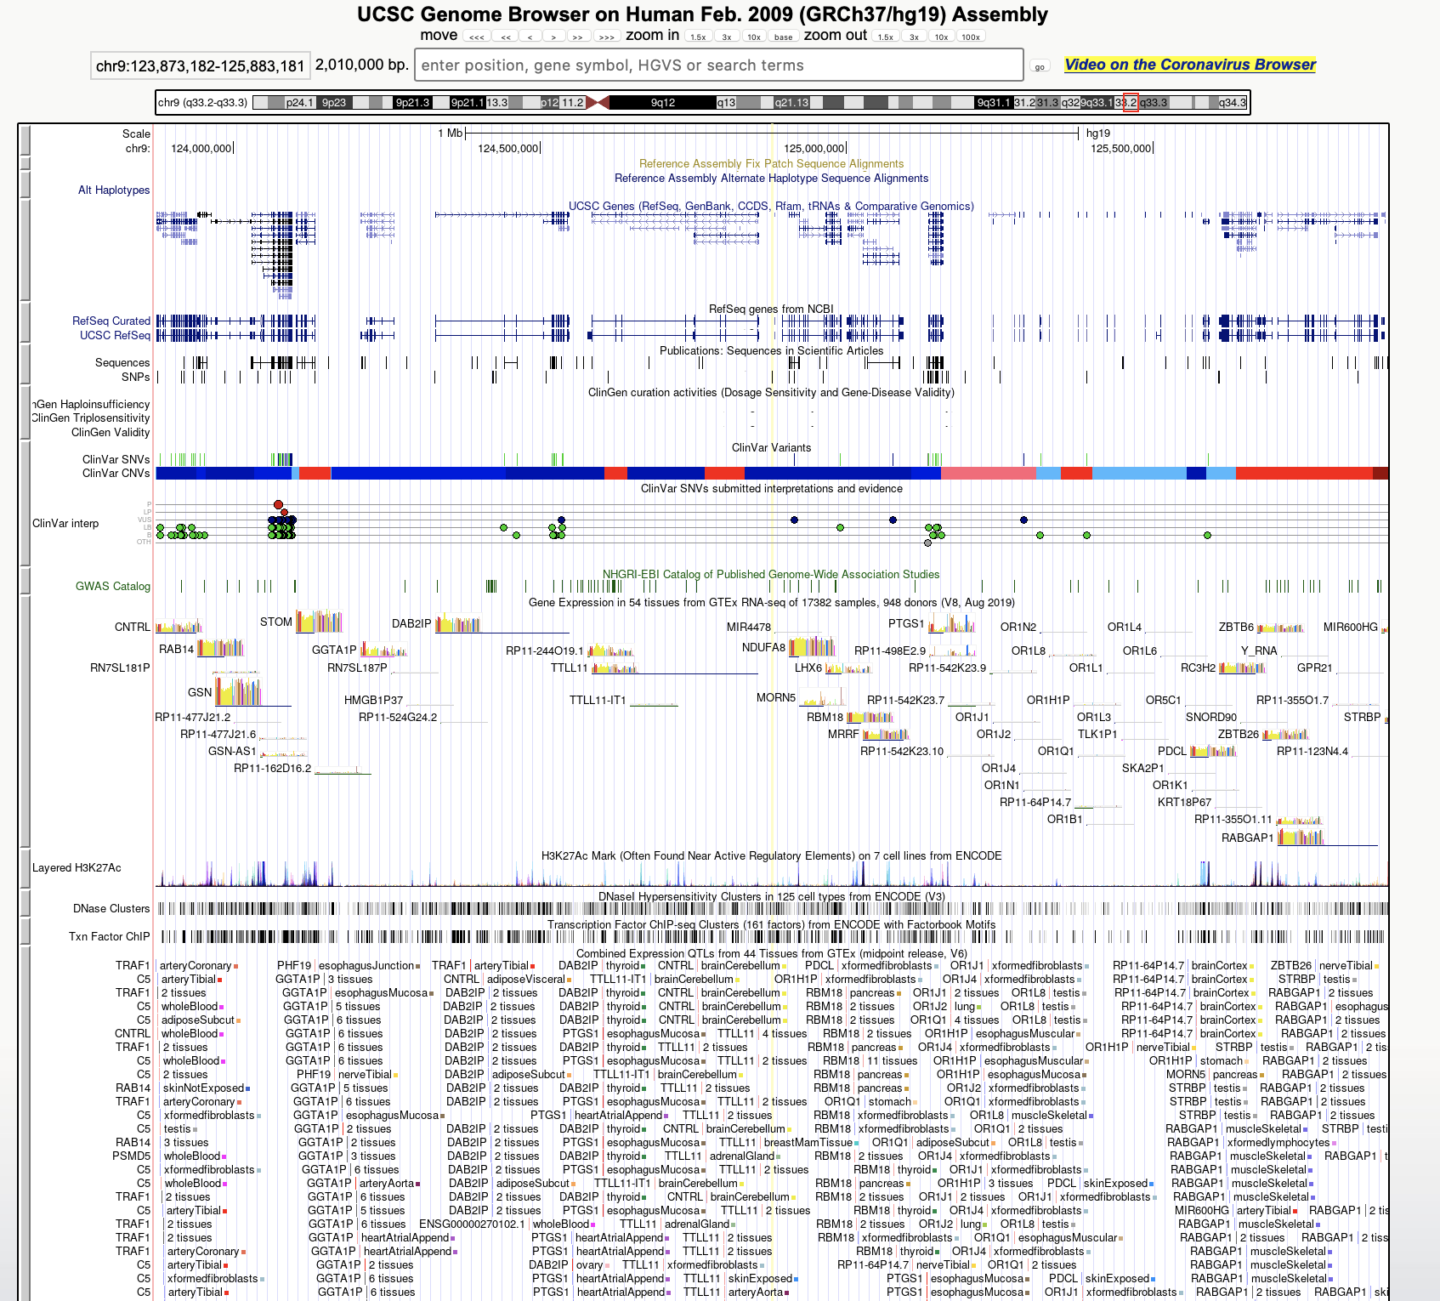
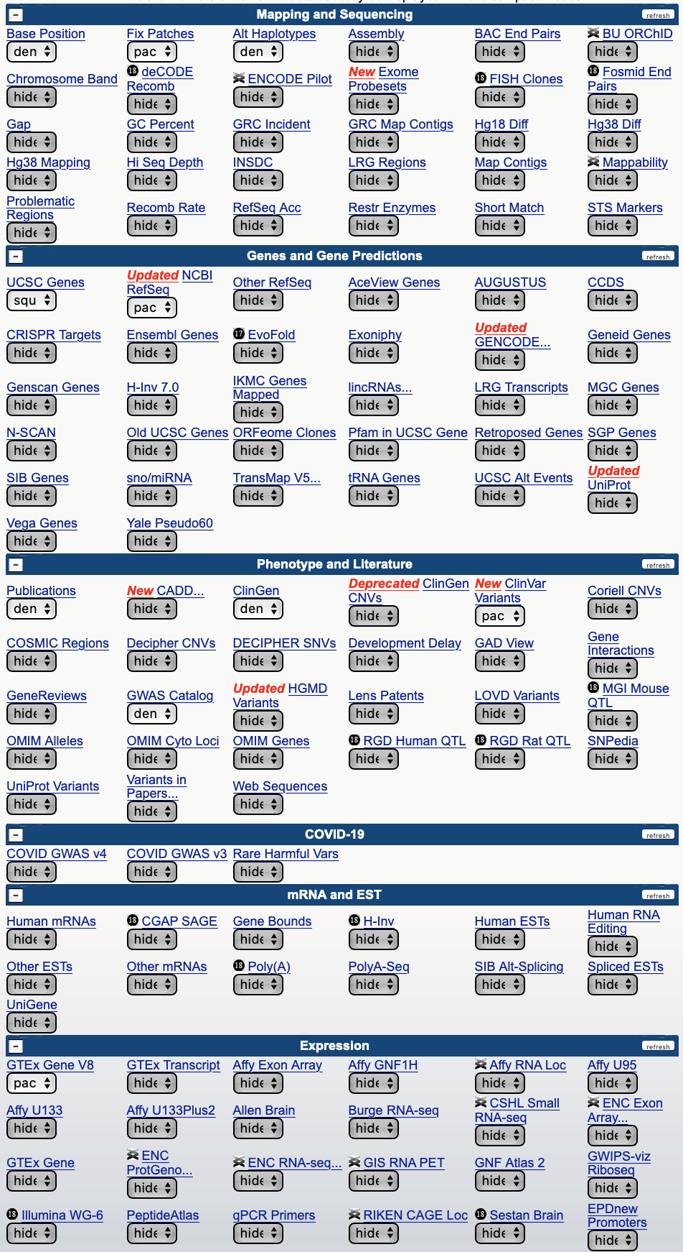
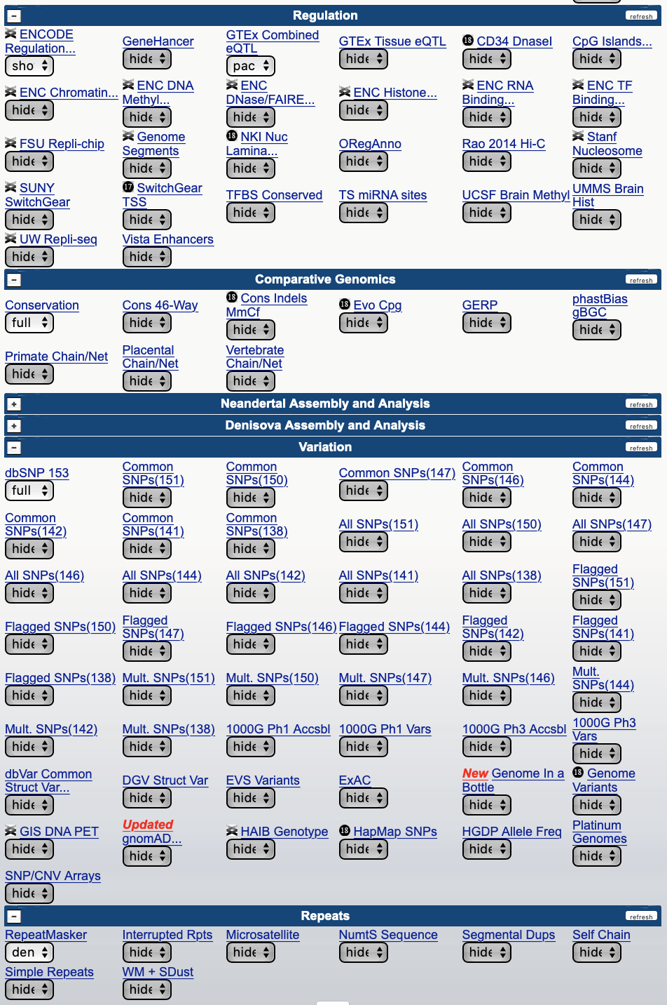
UCSC Genome Browser
You will learn to extract underlying data and to add your own tracks.

Slide 22
More variant-level information
Known phenotype associations
OMIM (Online Mendelian Inheritance in Man)
GWAS Catalog
PheWeb
More
LD
TOPMED
1000 Genomes Project
More
Other, including predicted effects
SIFT (conservation score)
PolyPhen (non-synonymous SNP deleteriousness score)
CADD (a composite deleteriousness score)

Slide 23
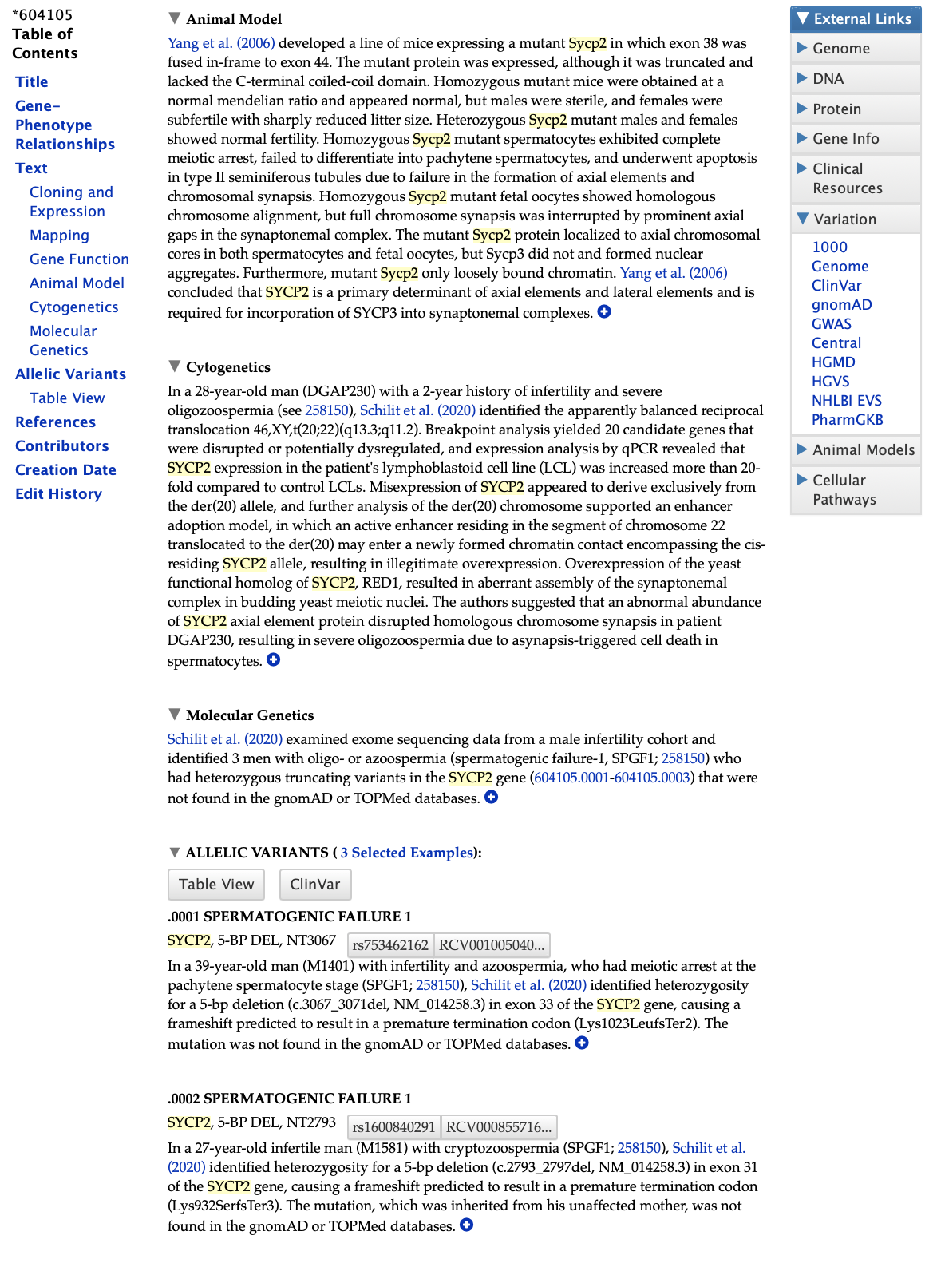
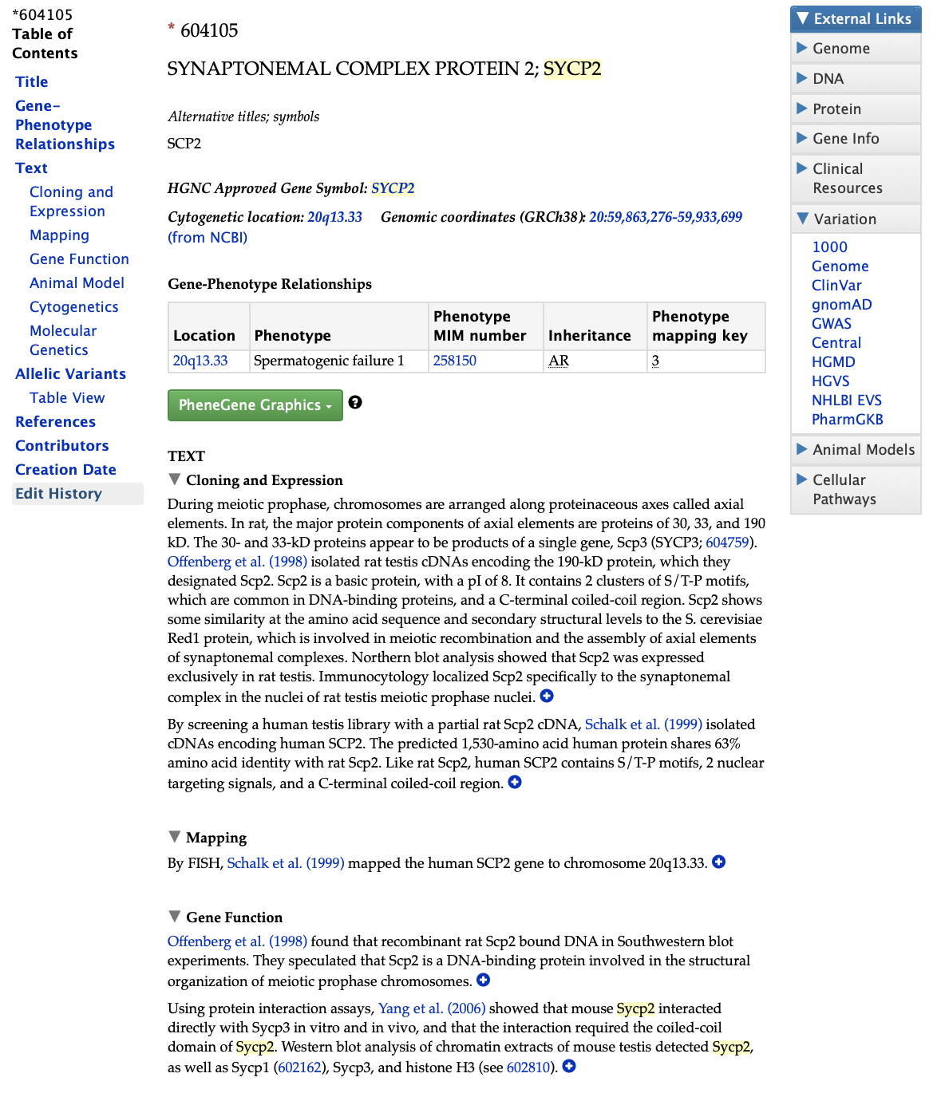
OMIM
https://omim.org

Slide 24
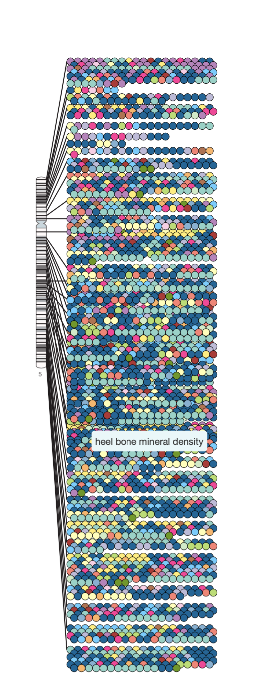
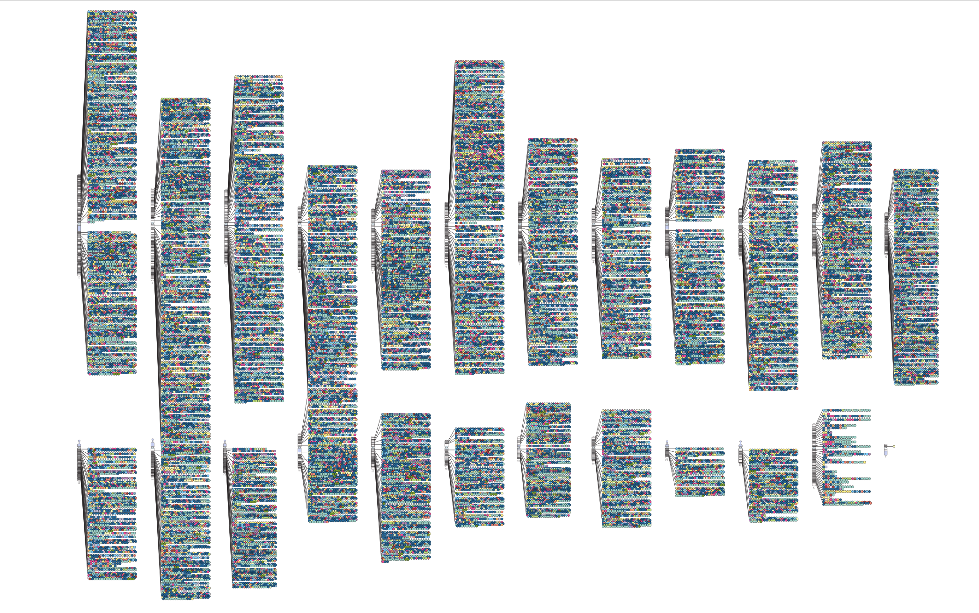
GWAS Catalog
https://www.ebi.ac.uk/gwas/

Slide 25
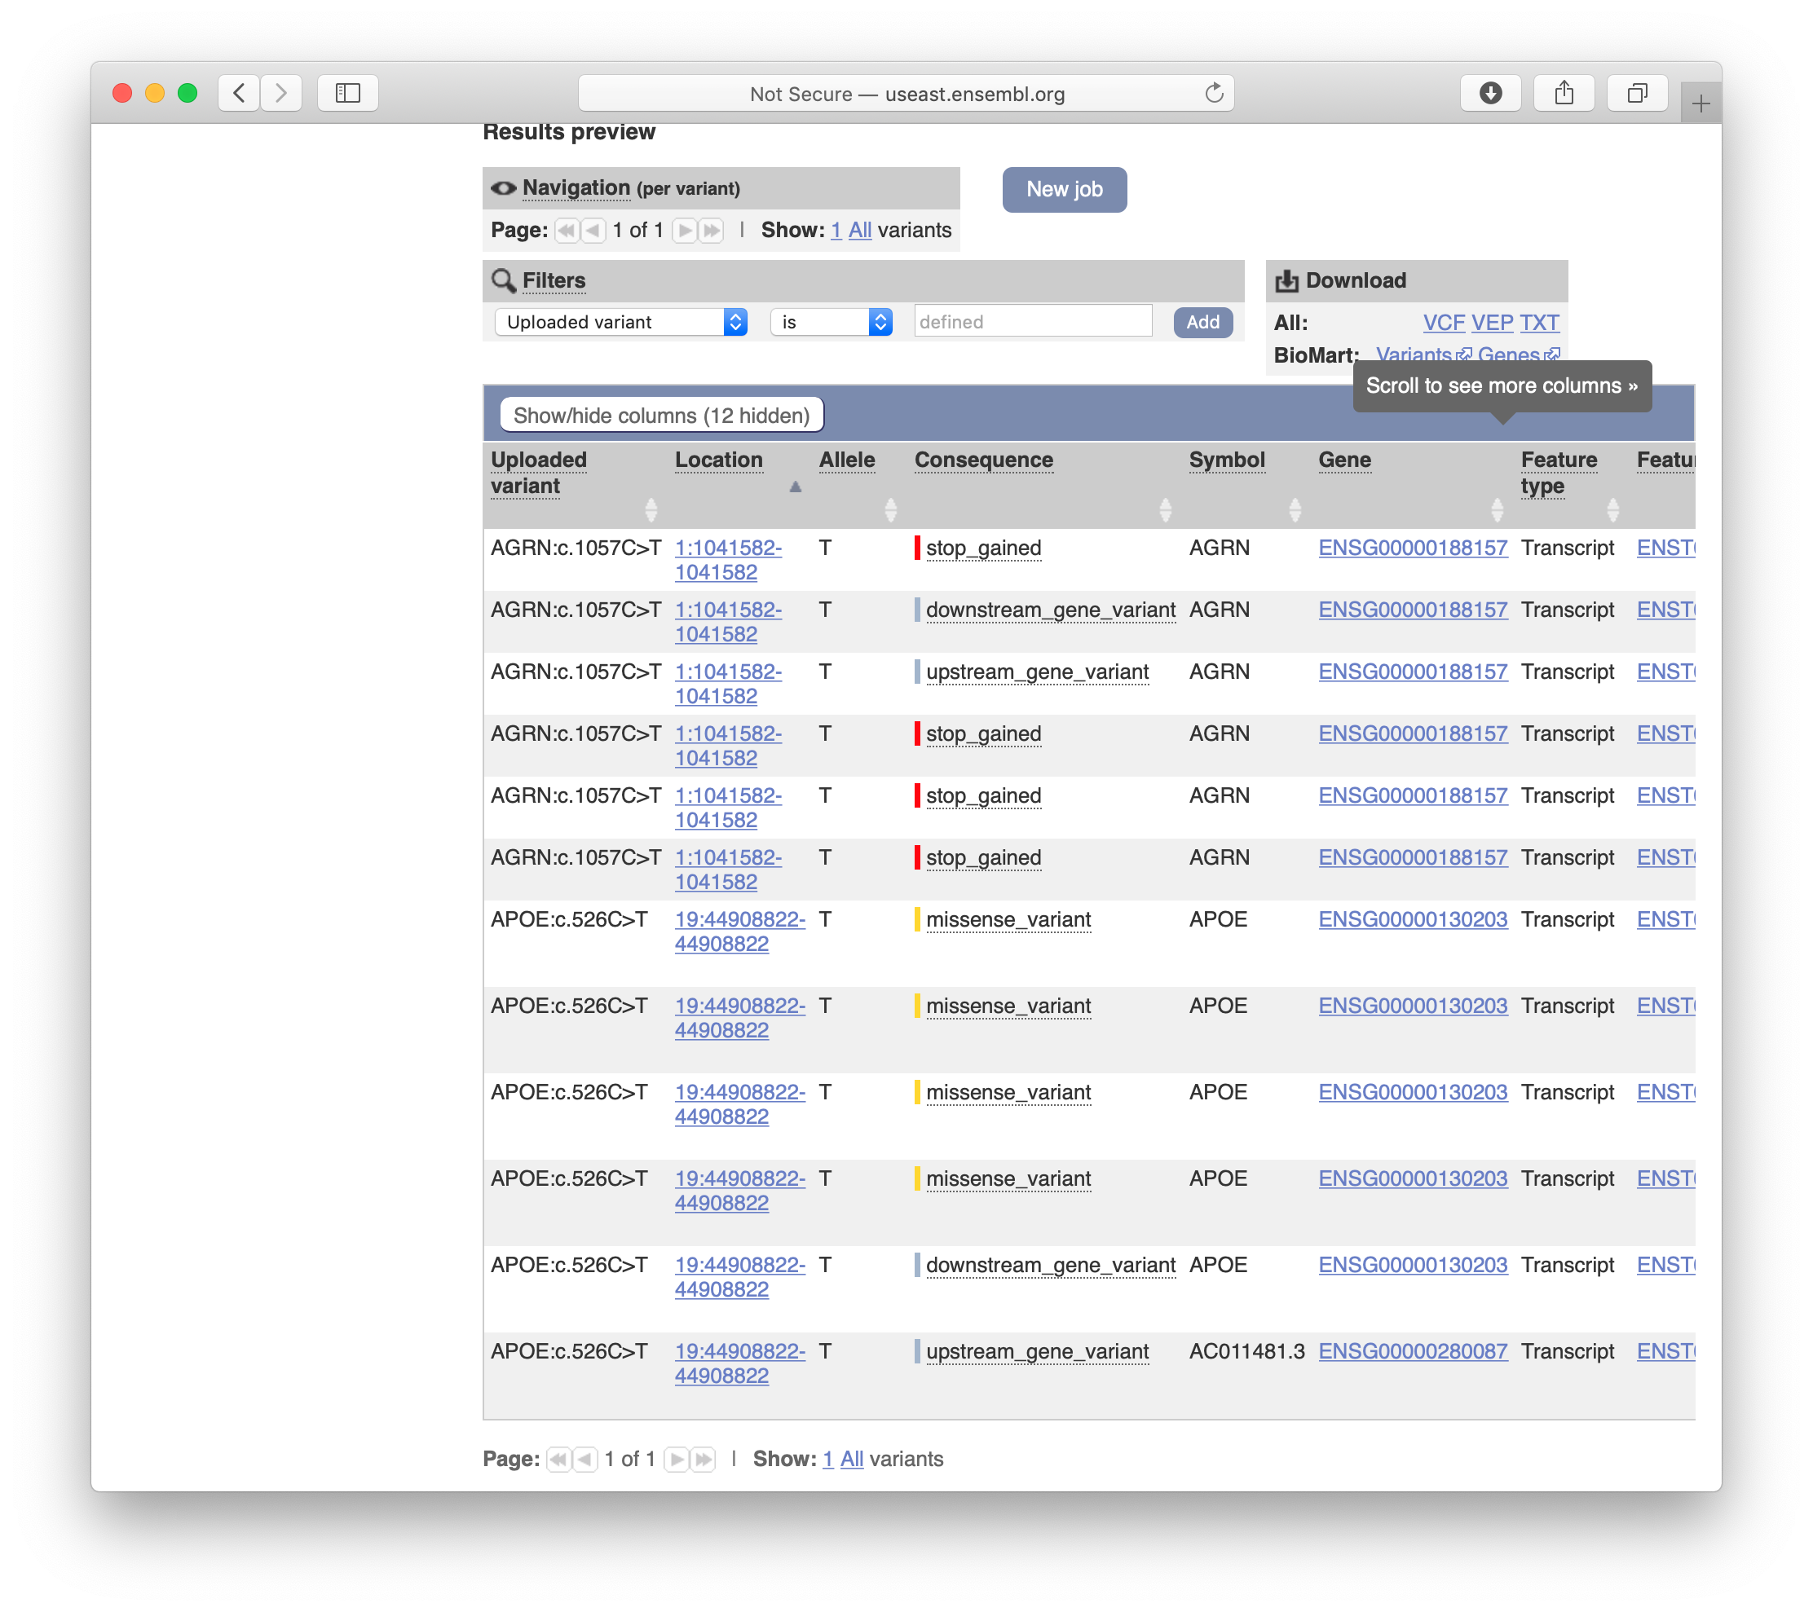
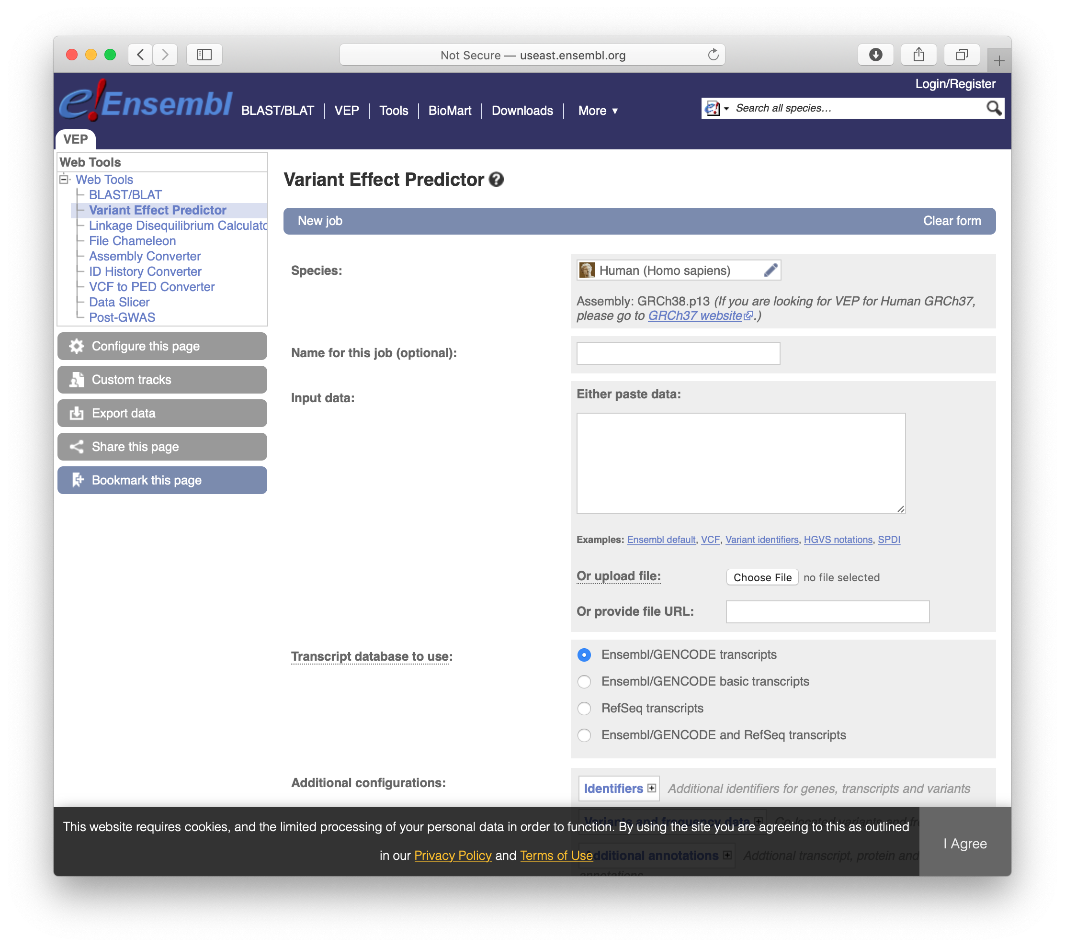
Variant Effect Predictor (VEP)
ensembl.org/Tools/VEP

Slide 26
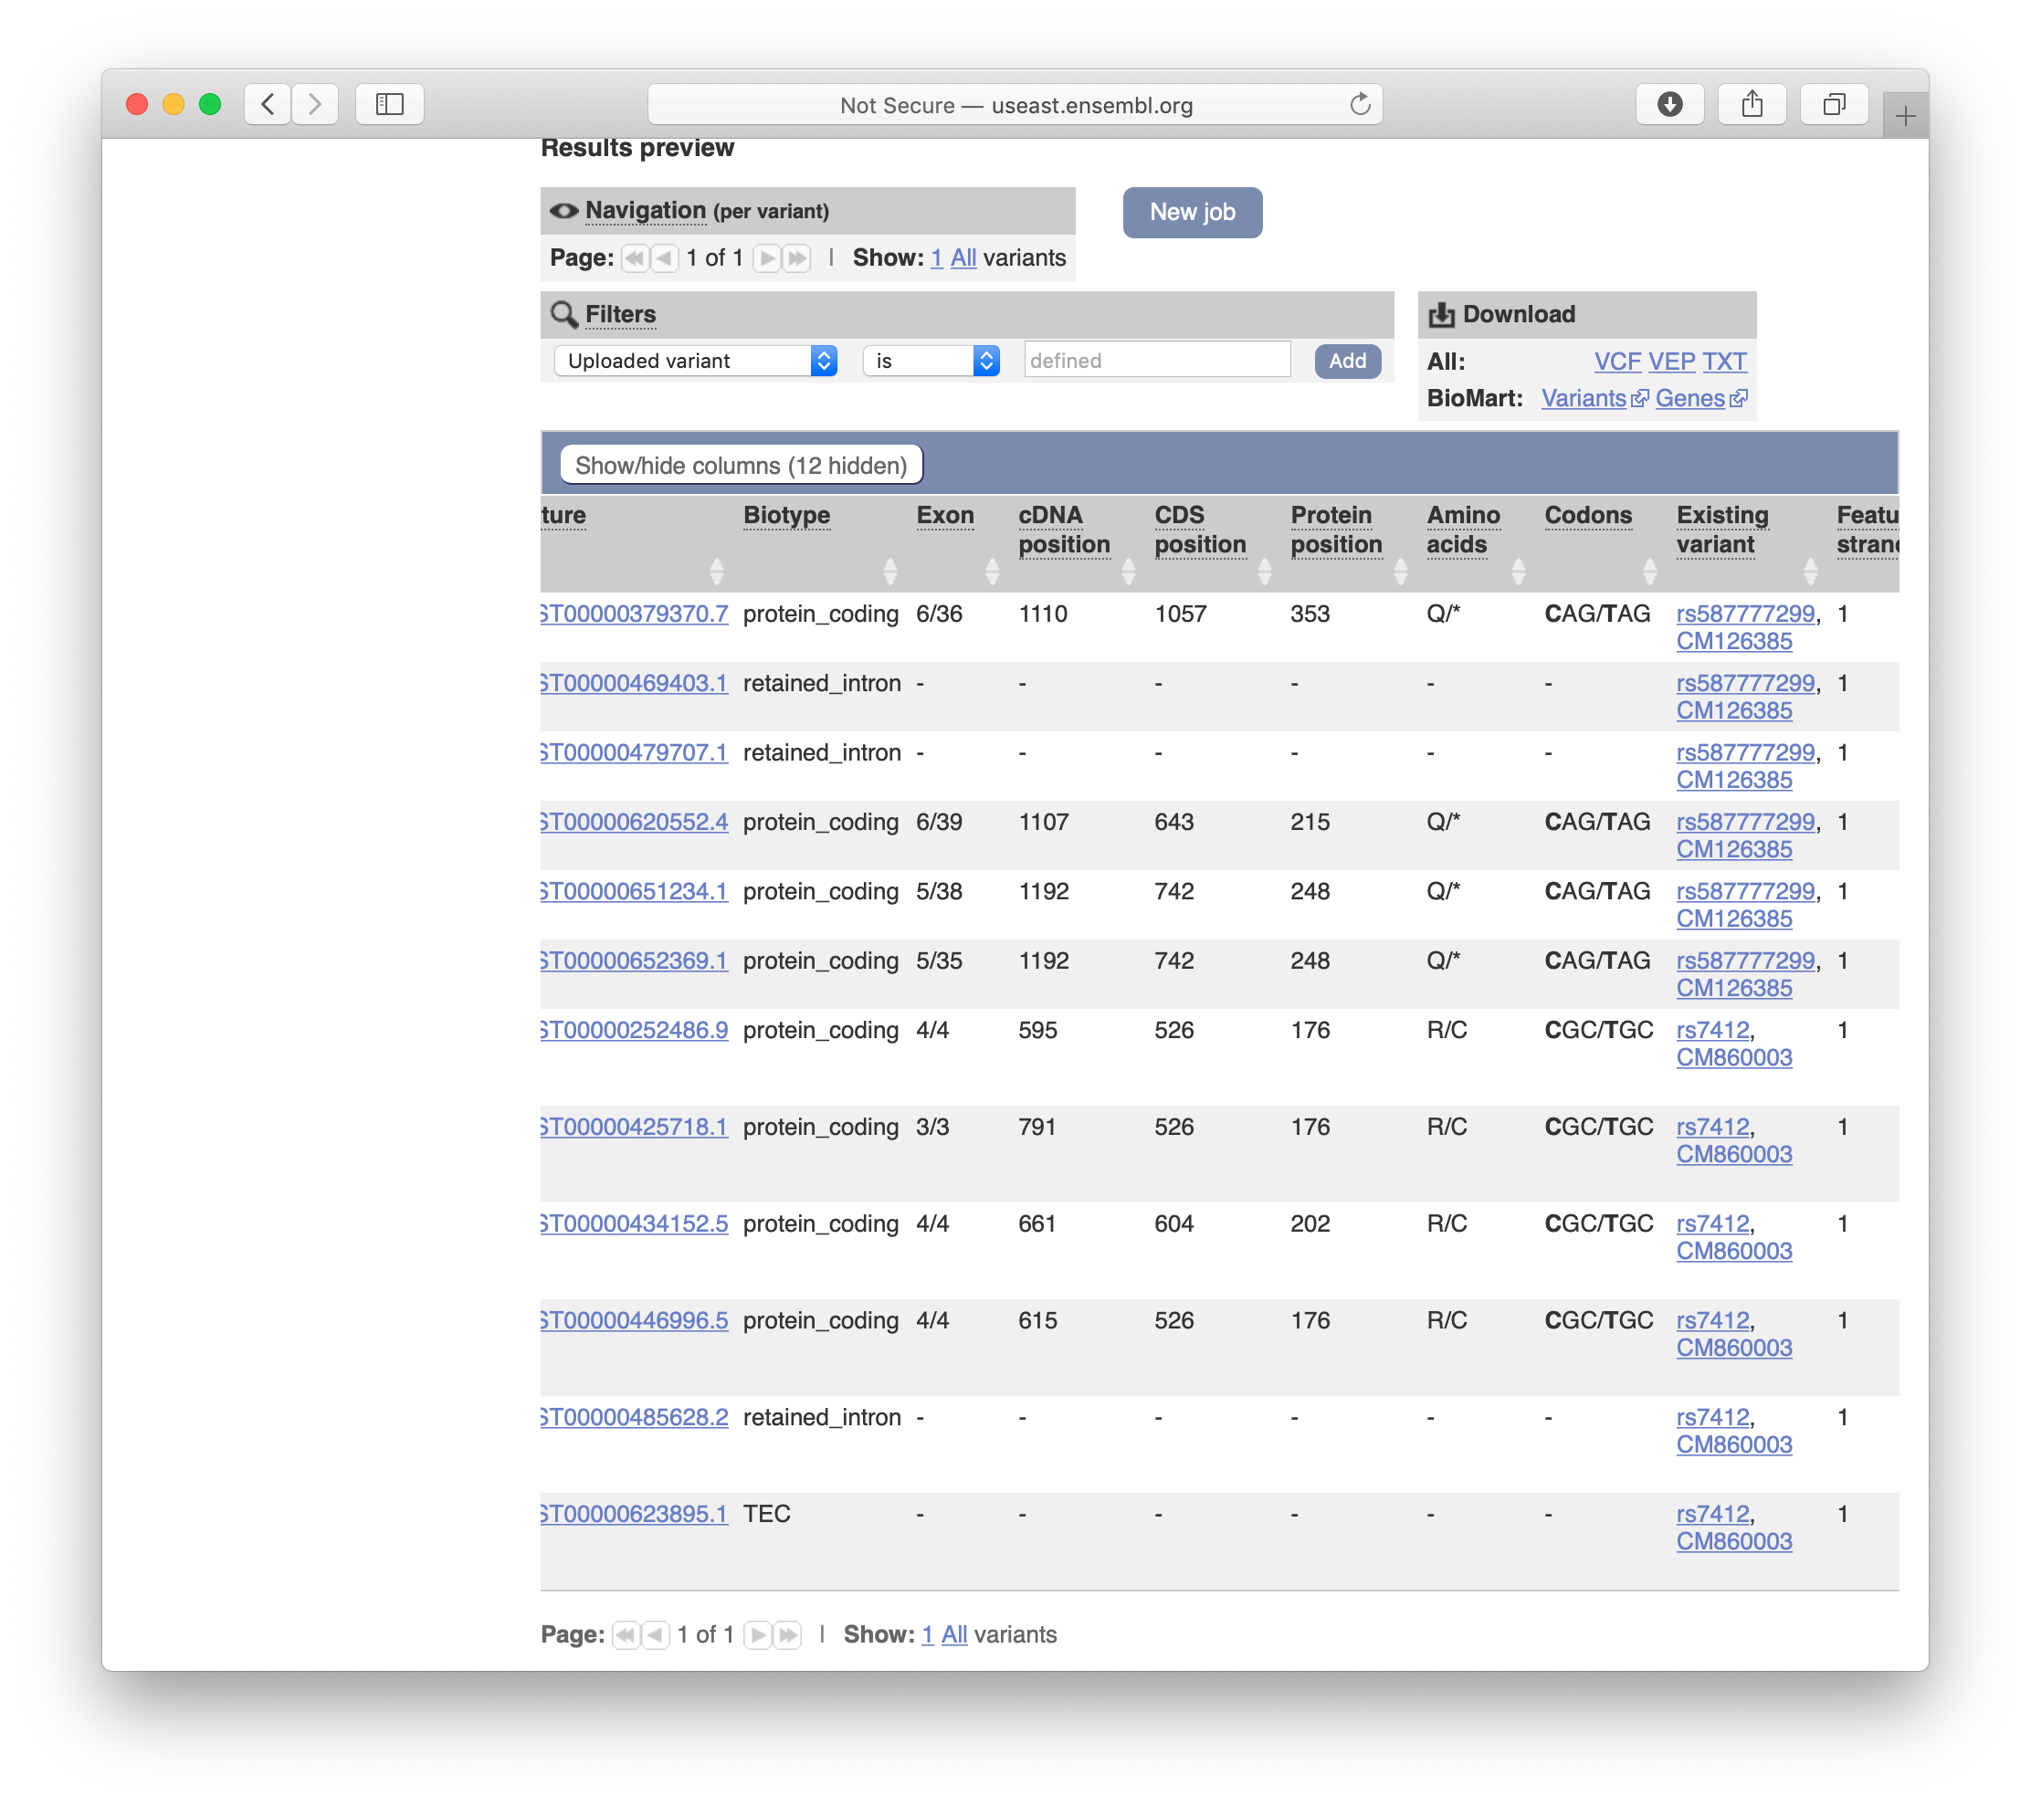
VEP

Slide 27
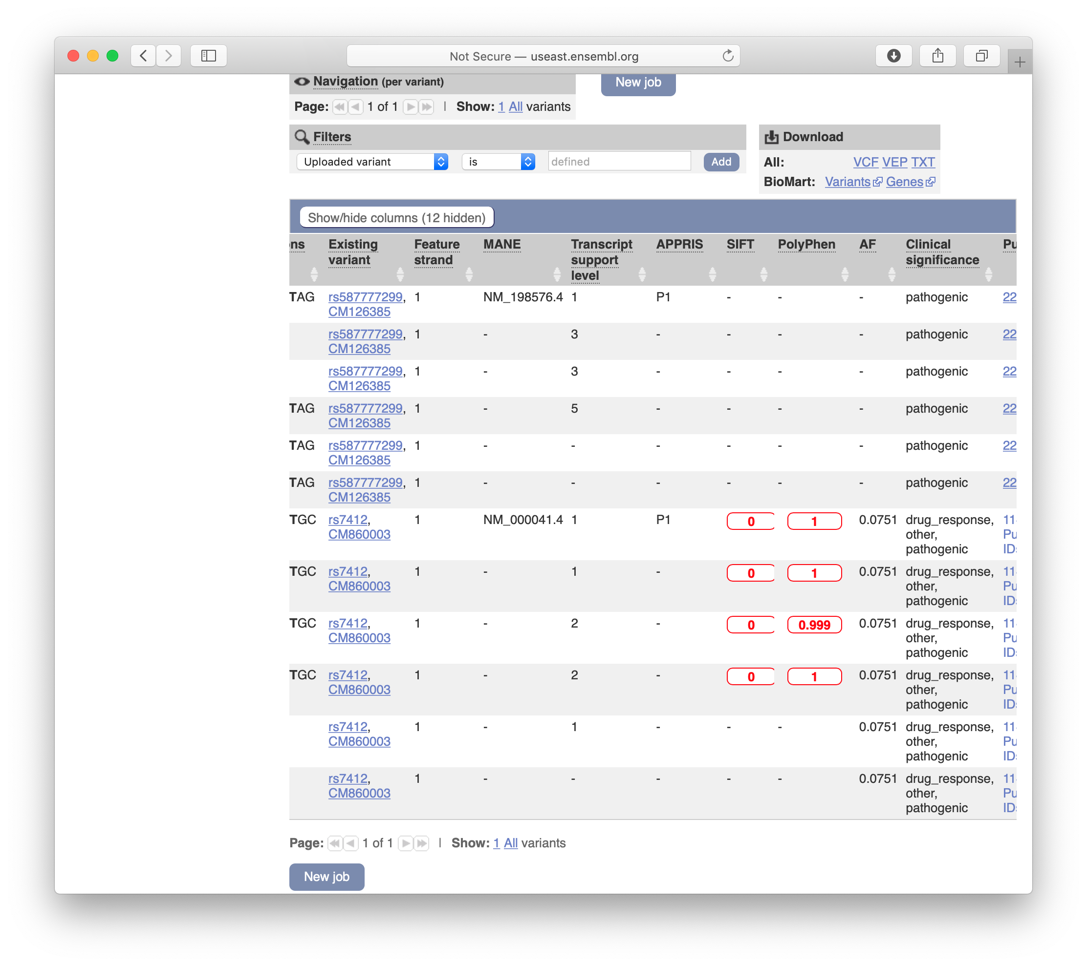
VEP

Slide 28
Distribution of Sequence
4. Repetitive regions of the genome
3. Non-coding, non-conserved, unique regions of the 3. genome
2. Evolutionarily conserved or putative regulatory 2. sequences
1. Coding sequences, including exons, splice sites, and 1. non-coding RNA genes
Koboldt. massgenomics.org 2012

Slide 29
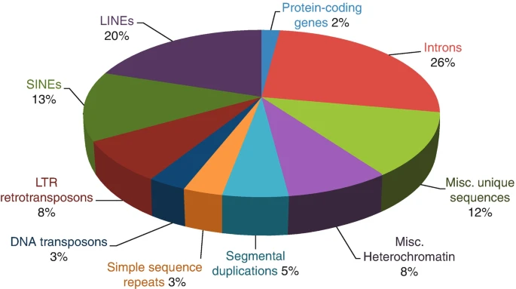
Classes of Functional Variation
Genic
Coding
Synonymous
Non-synonymous
Missense
Nonsense
Non-Coding
Intergenic
Entire genome*
dbSNP 135*
*I am really sorry about these plots. It’s surprisingly hard to find non-3D graphs of genome composition.

Slide 30
What other positional information is out there?
Most associations won’t be situated squarely within one gene. There may be no gene nearby.
What other kinds of functional elements have been mapped in the genome?

Slide 31
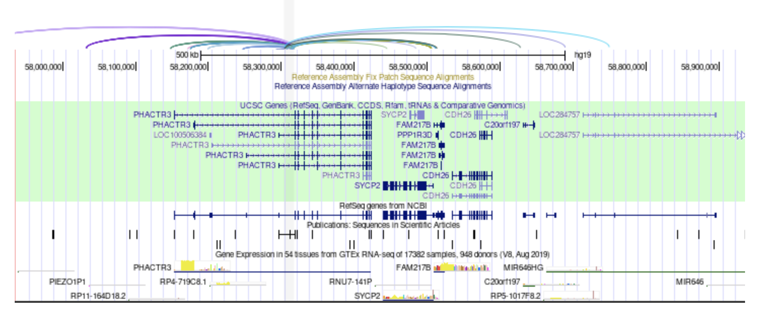
What other “positional” information is out there?
Is your SNP/variant in a region with any of the following annotations?
5’ or 3’ UTR
Regulatory elements (enhancers, e.g.)
Methylation
Acetylation
Other chromatin state info
DNAse sensitivity
Motifs and conservation
eQTLs
3-D interaction, topological domains

Slide 32
Enhancer Variation
Enhancers are distal regulatory elements that often lie 10 kbp–100 kpb (sometimes up to 1 Mpb) from the start of their target gene. Mutations within them can disrupt sequence motifs for sequence-specific transcription factors, chromatin regulators and nucleosome positioning signals.

Slide 33
Examples of databases with non-coding/regulatory element information
ENCODE (Encyclopedia of DNA Elements)
Roadmap Epigenomics Project
GTEx
Others…

Slide 34
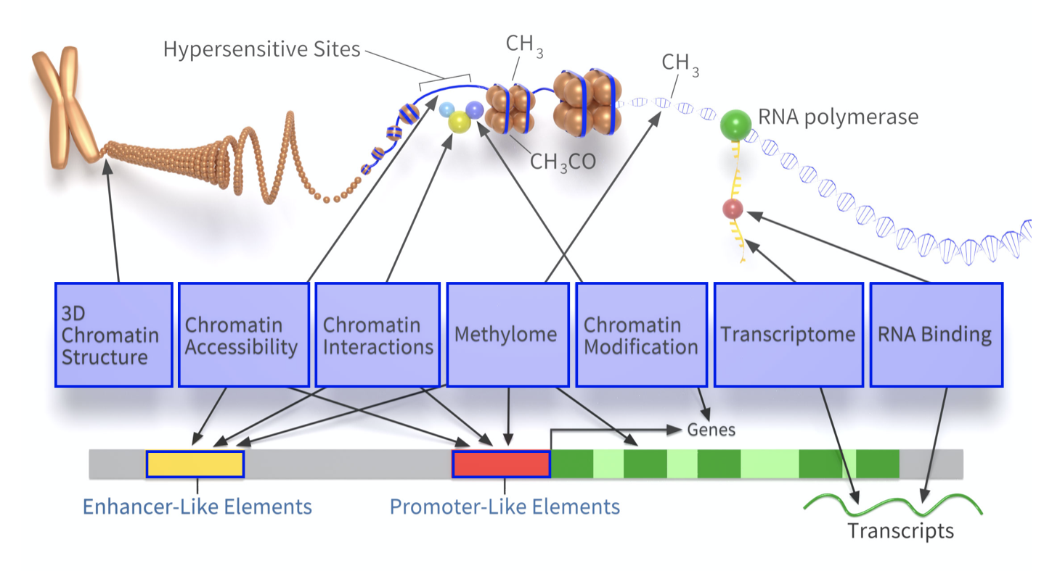
ENCODE
https://www.encodeproject.org

Slide 35
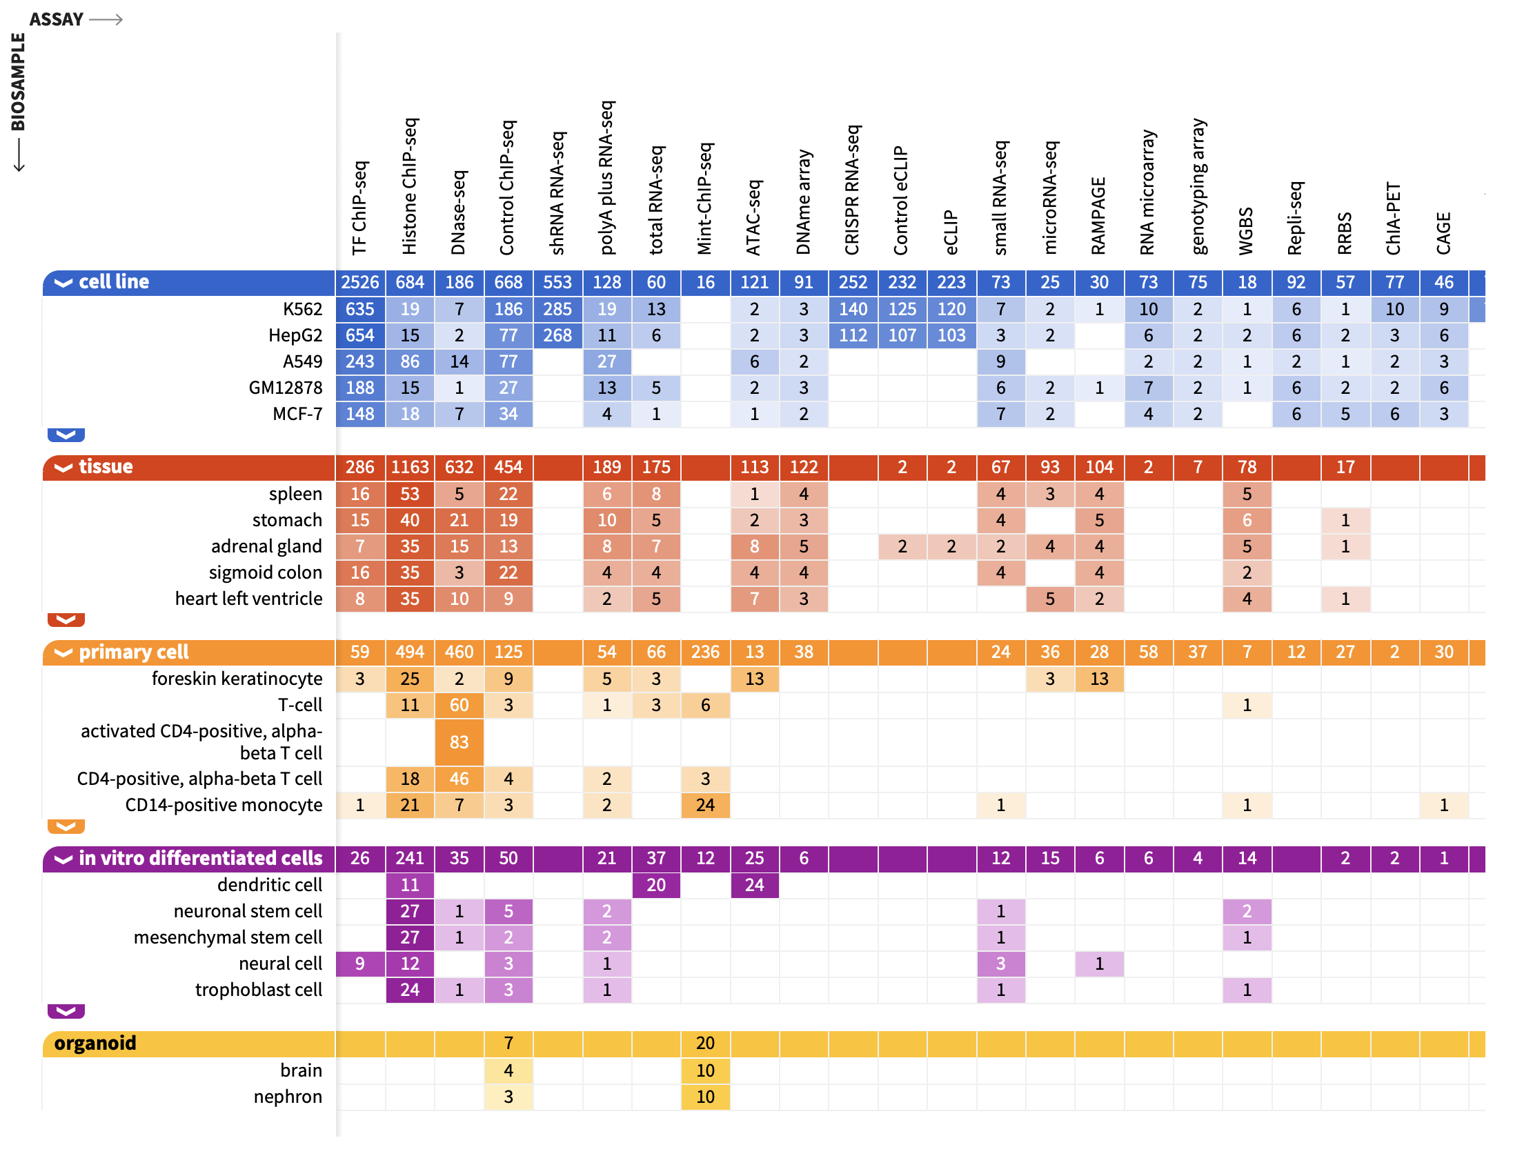
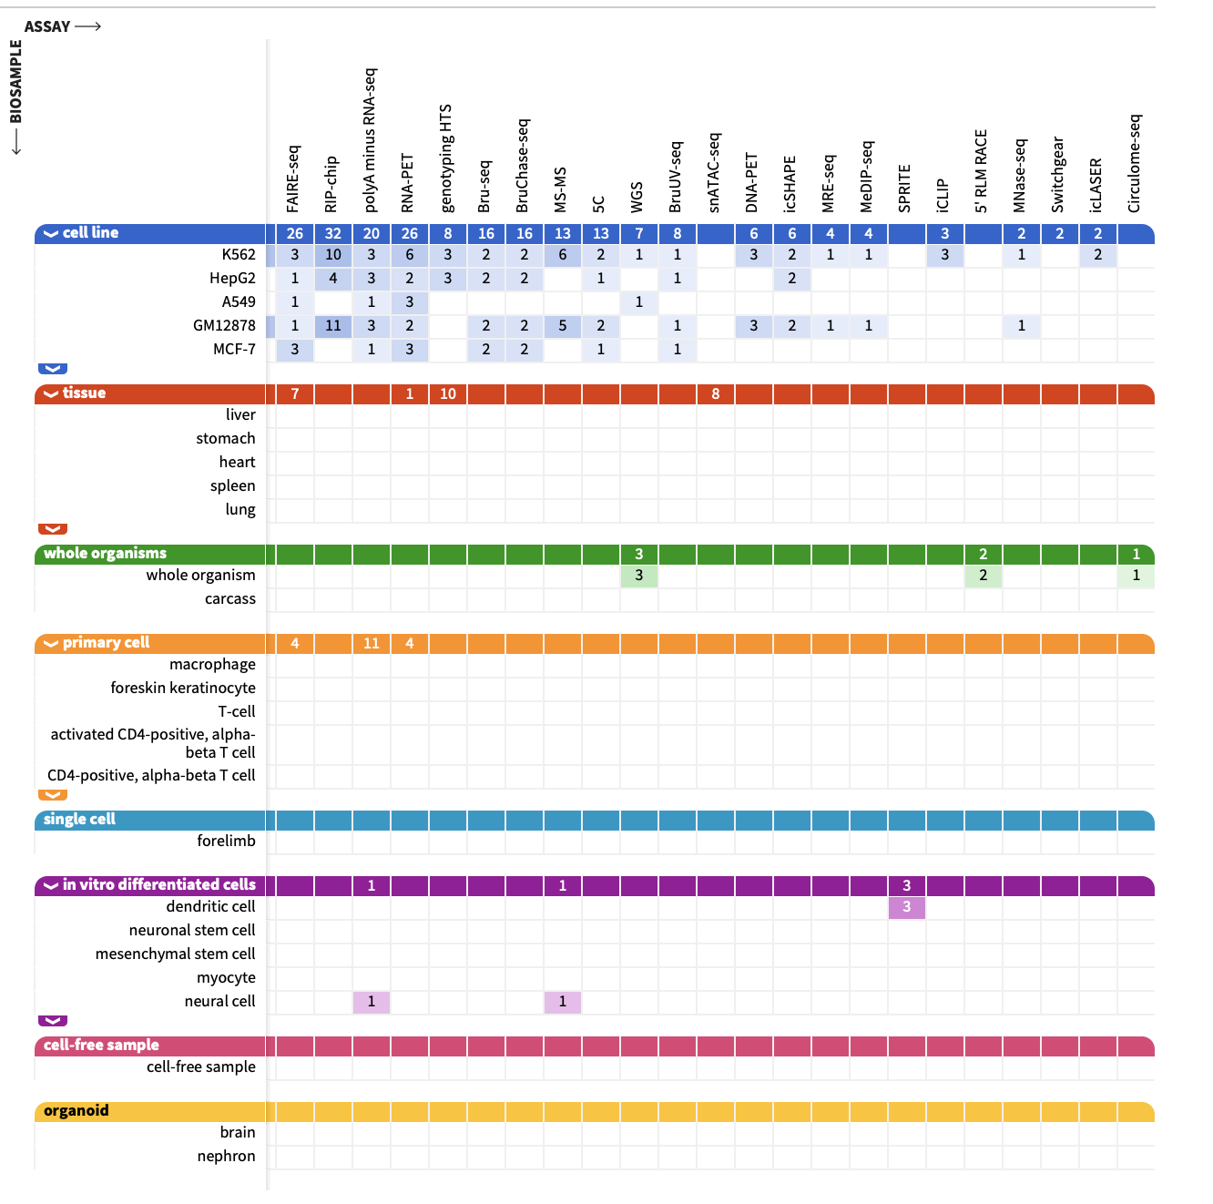
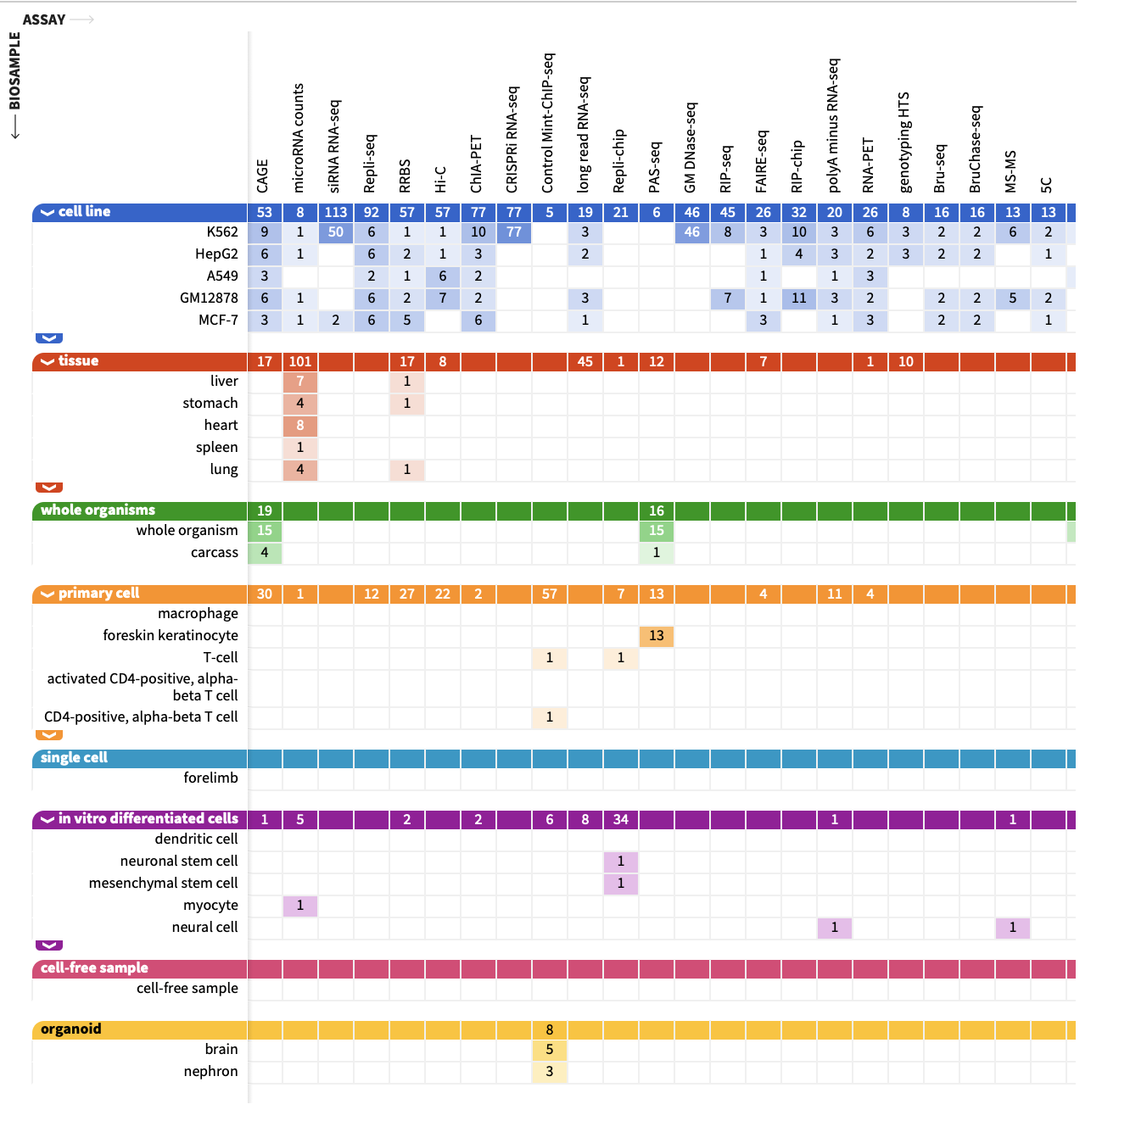
ENCODE
← Samples →
← Assays →

Slide 36
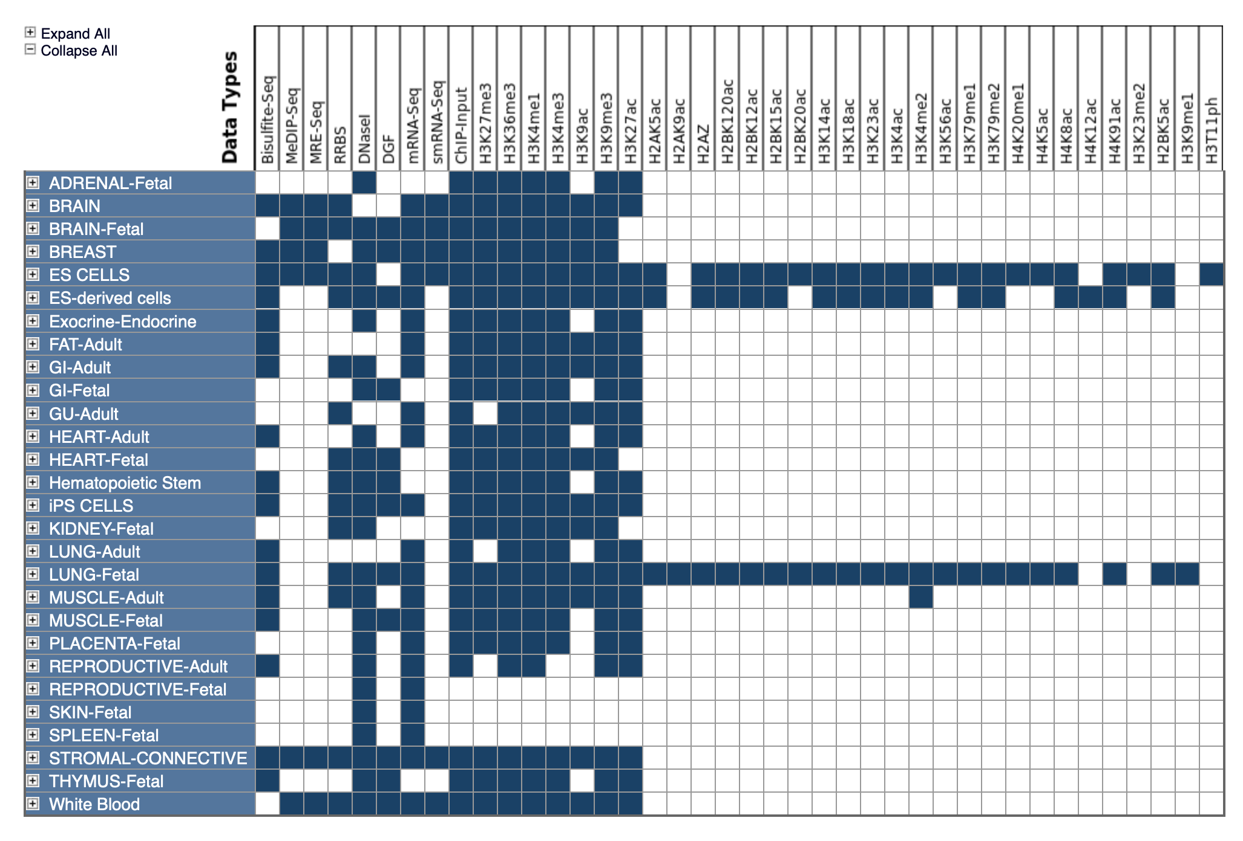
Roadmap
http://www.roadmapepigenomics.org

Slide 37
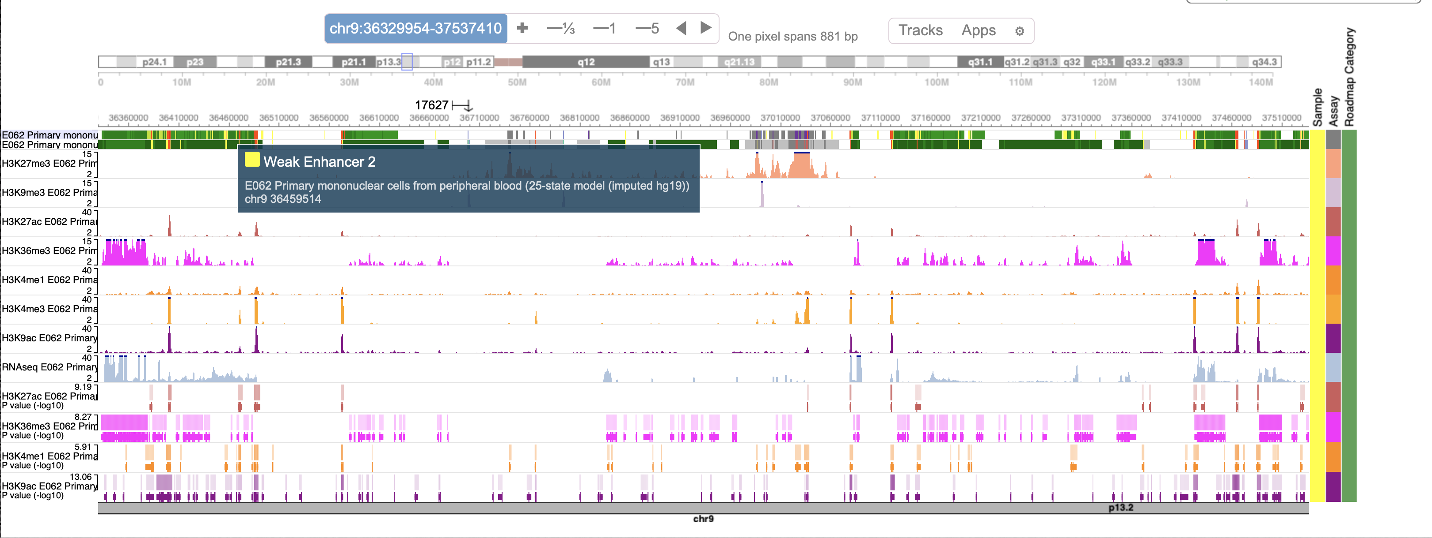
Roadmap

Slide 38
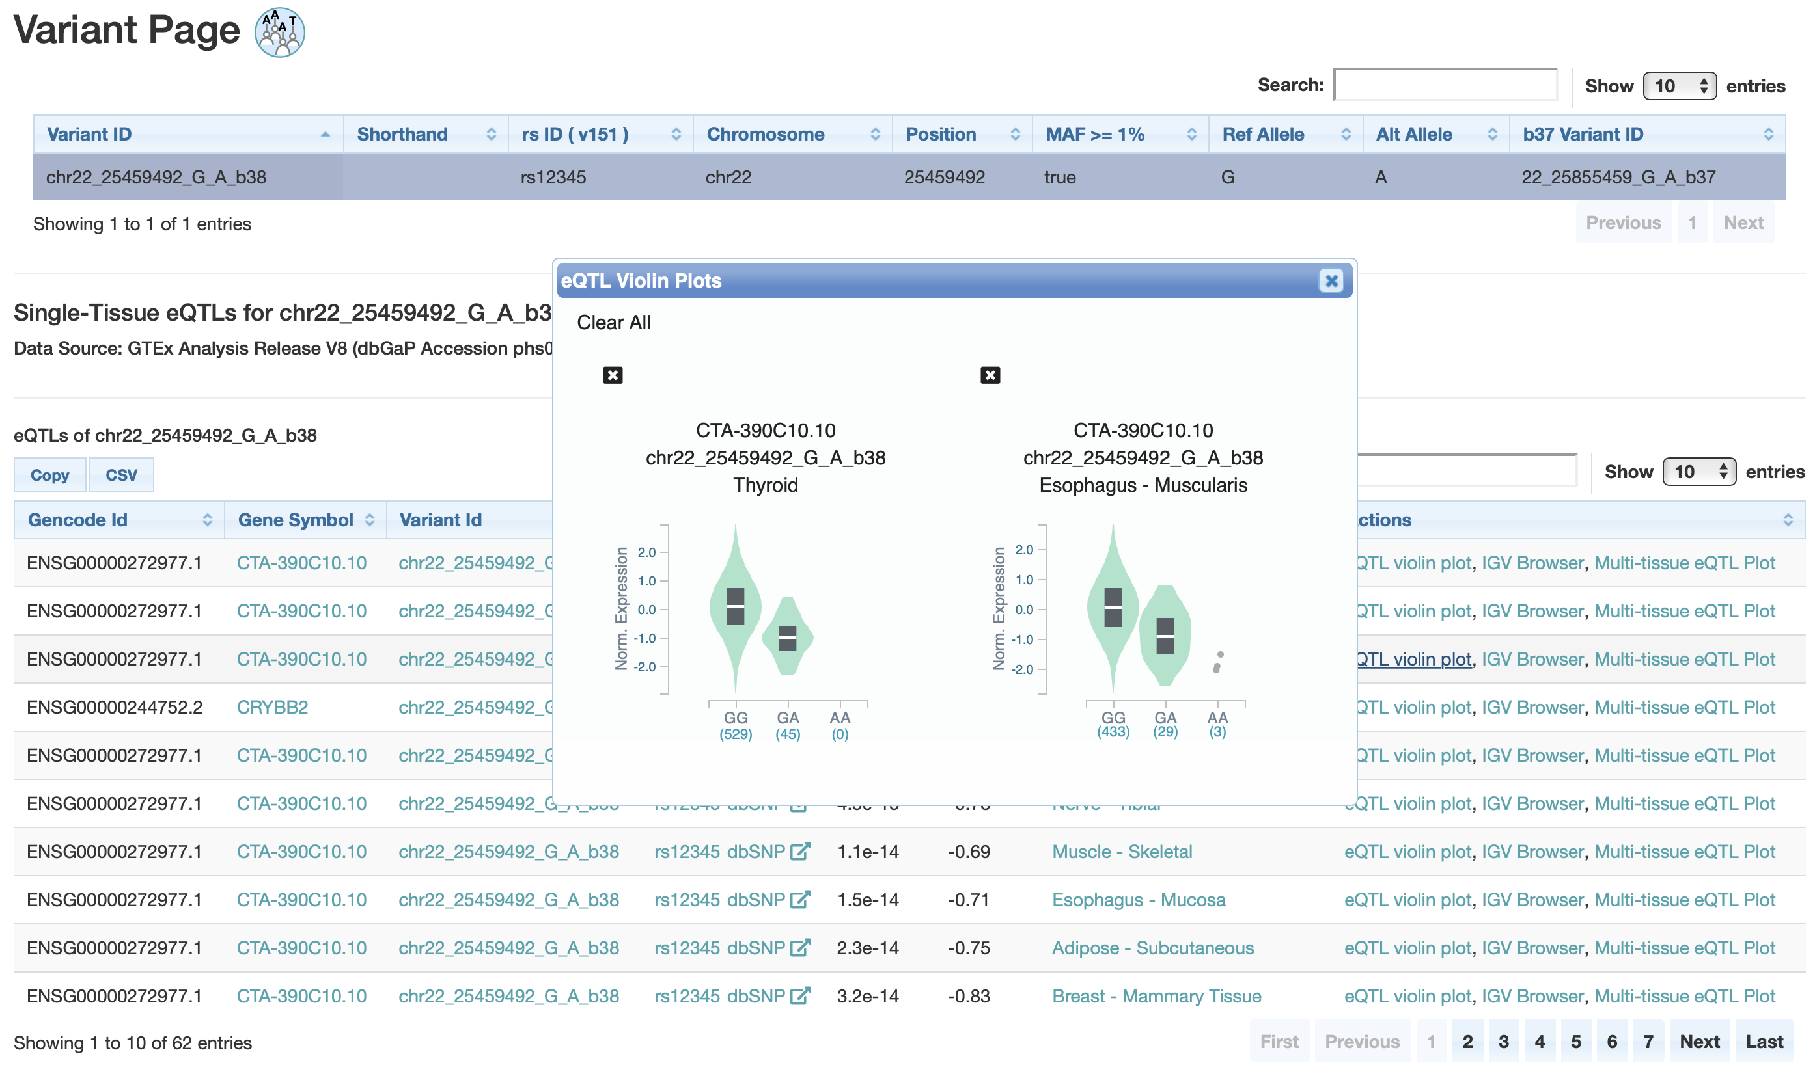
GTEx
I searched “rs12345”
https://gtexportal.org/

Slide 39
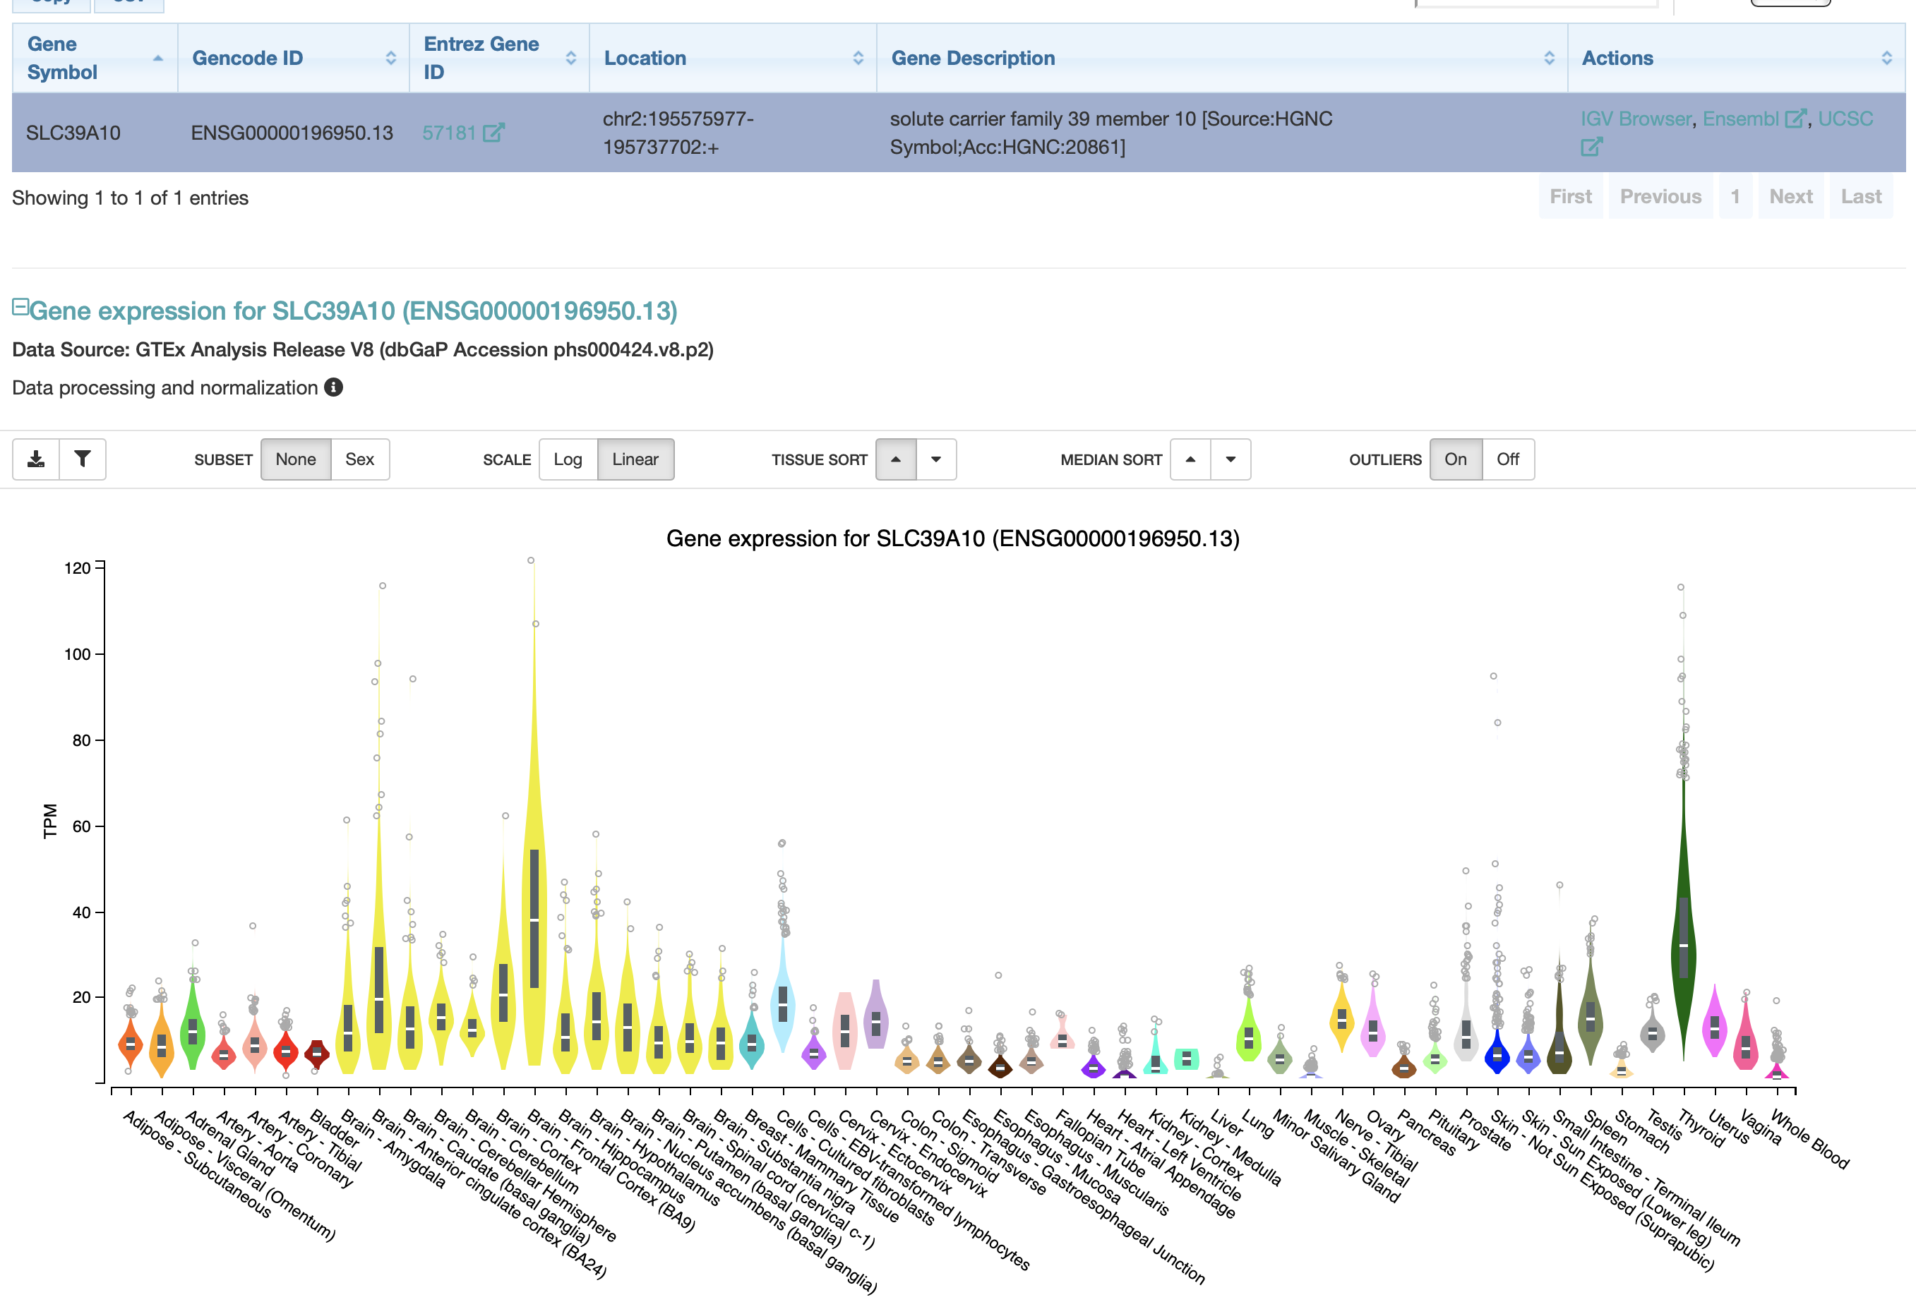
GTEx
I searched “SLC39A10”

Slide 40
Examples of tools
HaploReg
RegulomeDB
GTEx (portal)
Genome browser(s)
FUMA

Slide 41
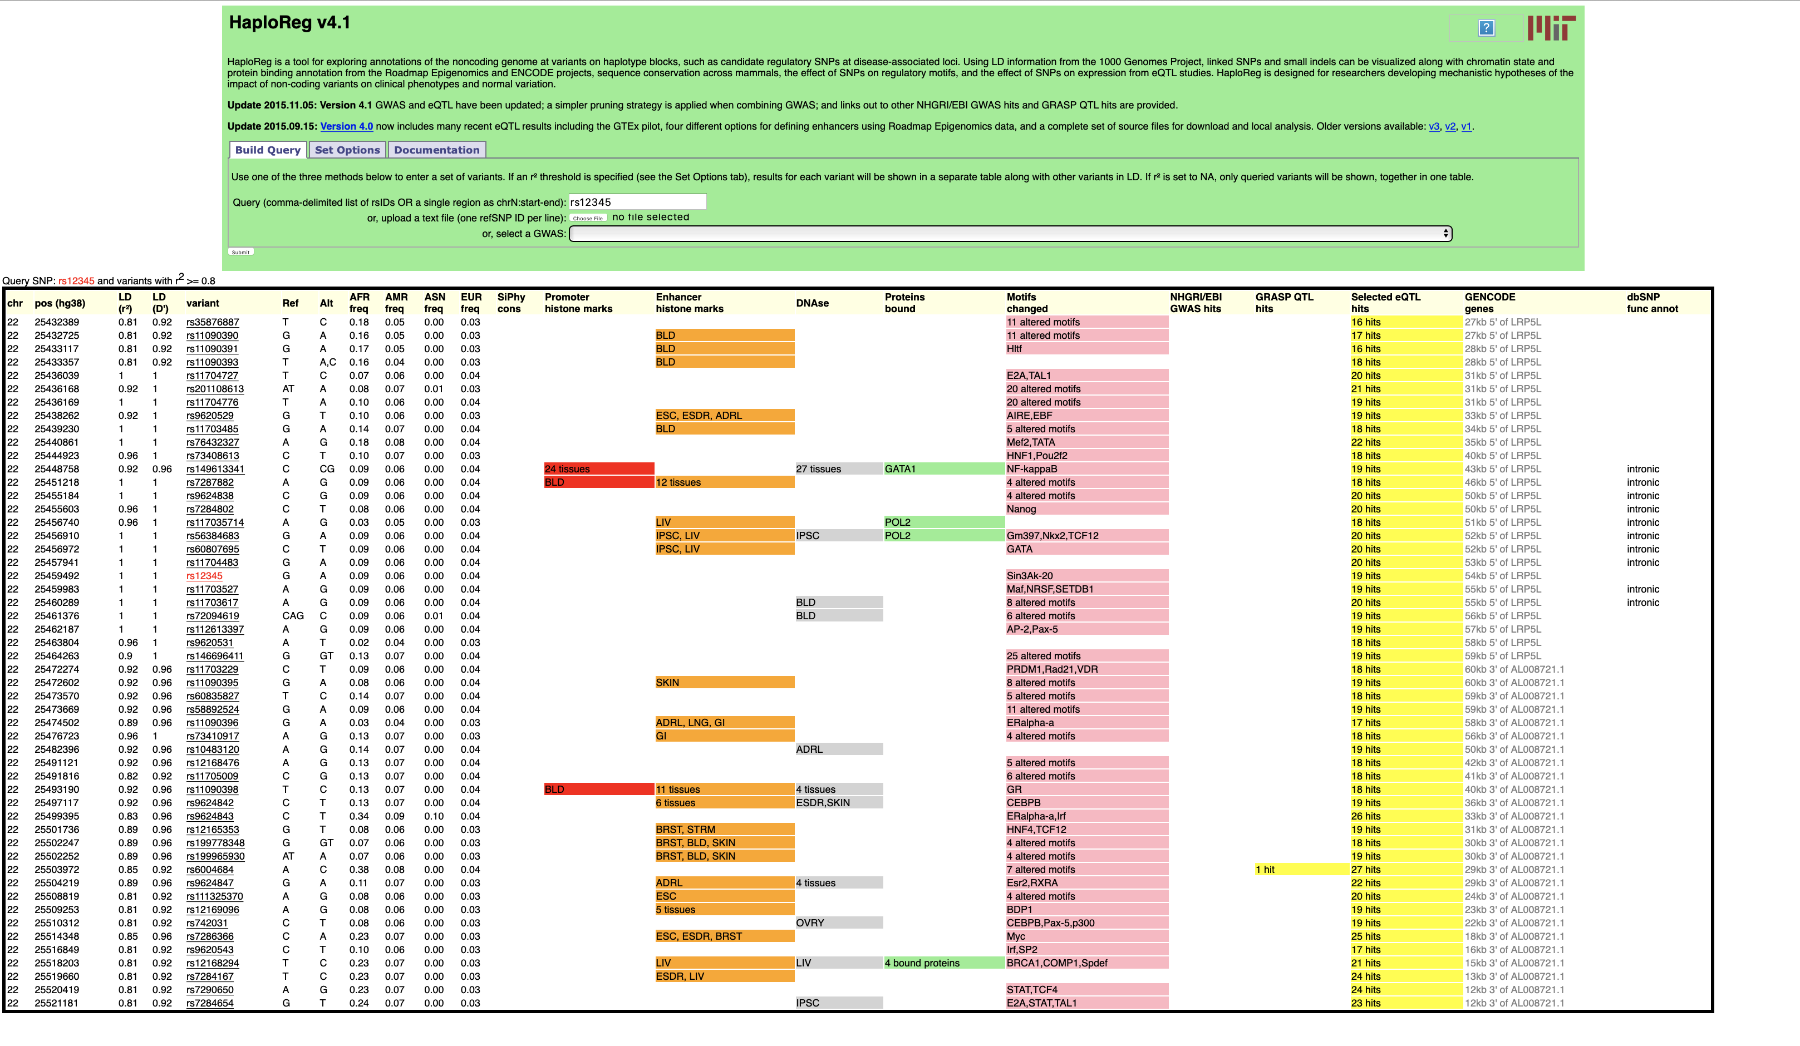
HaploReg
https://pubs.broadinstitute.org/mammals/haploreg/haploreg.php
I searched “rs12345”

Slide 42
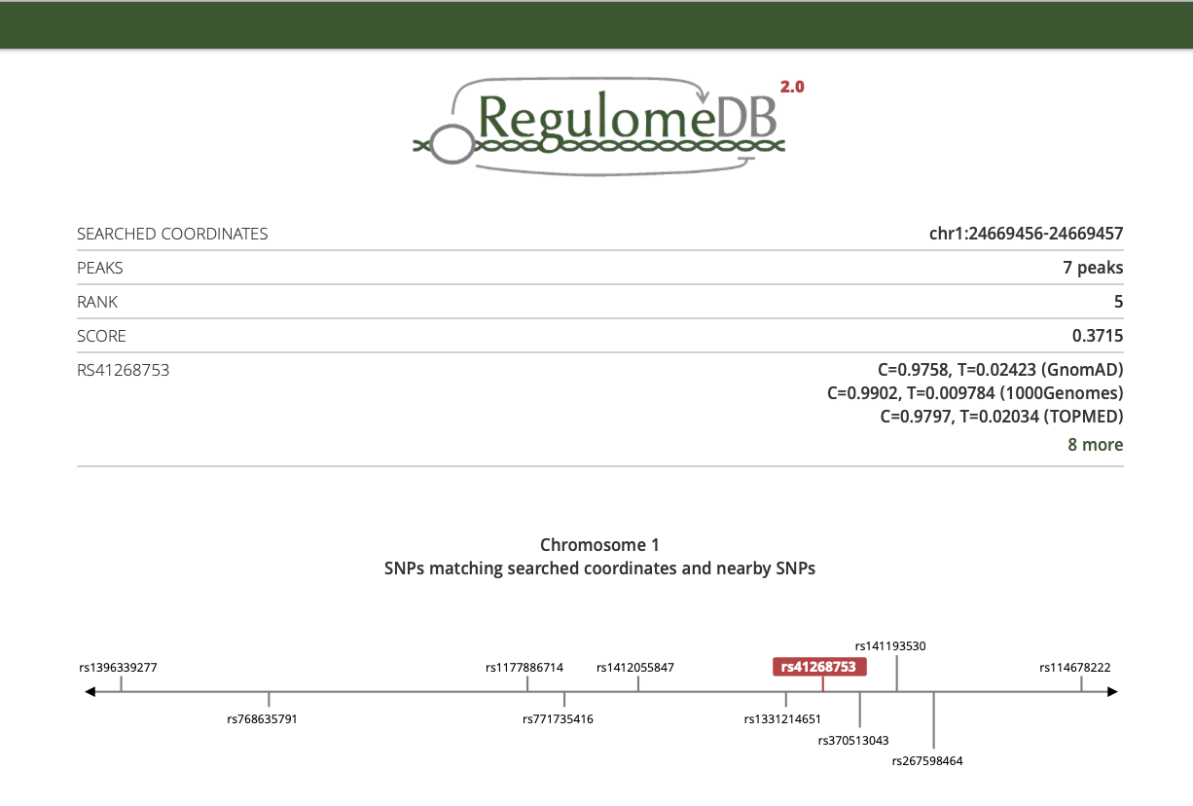
RegulomeDB
https://regulomedb.org/regulome-search/

Slide 43
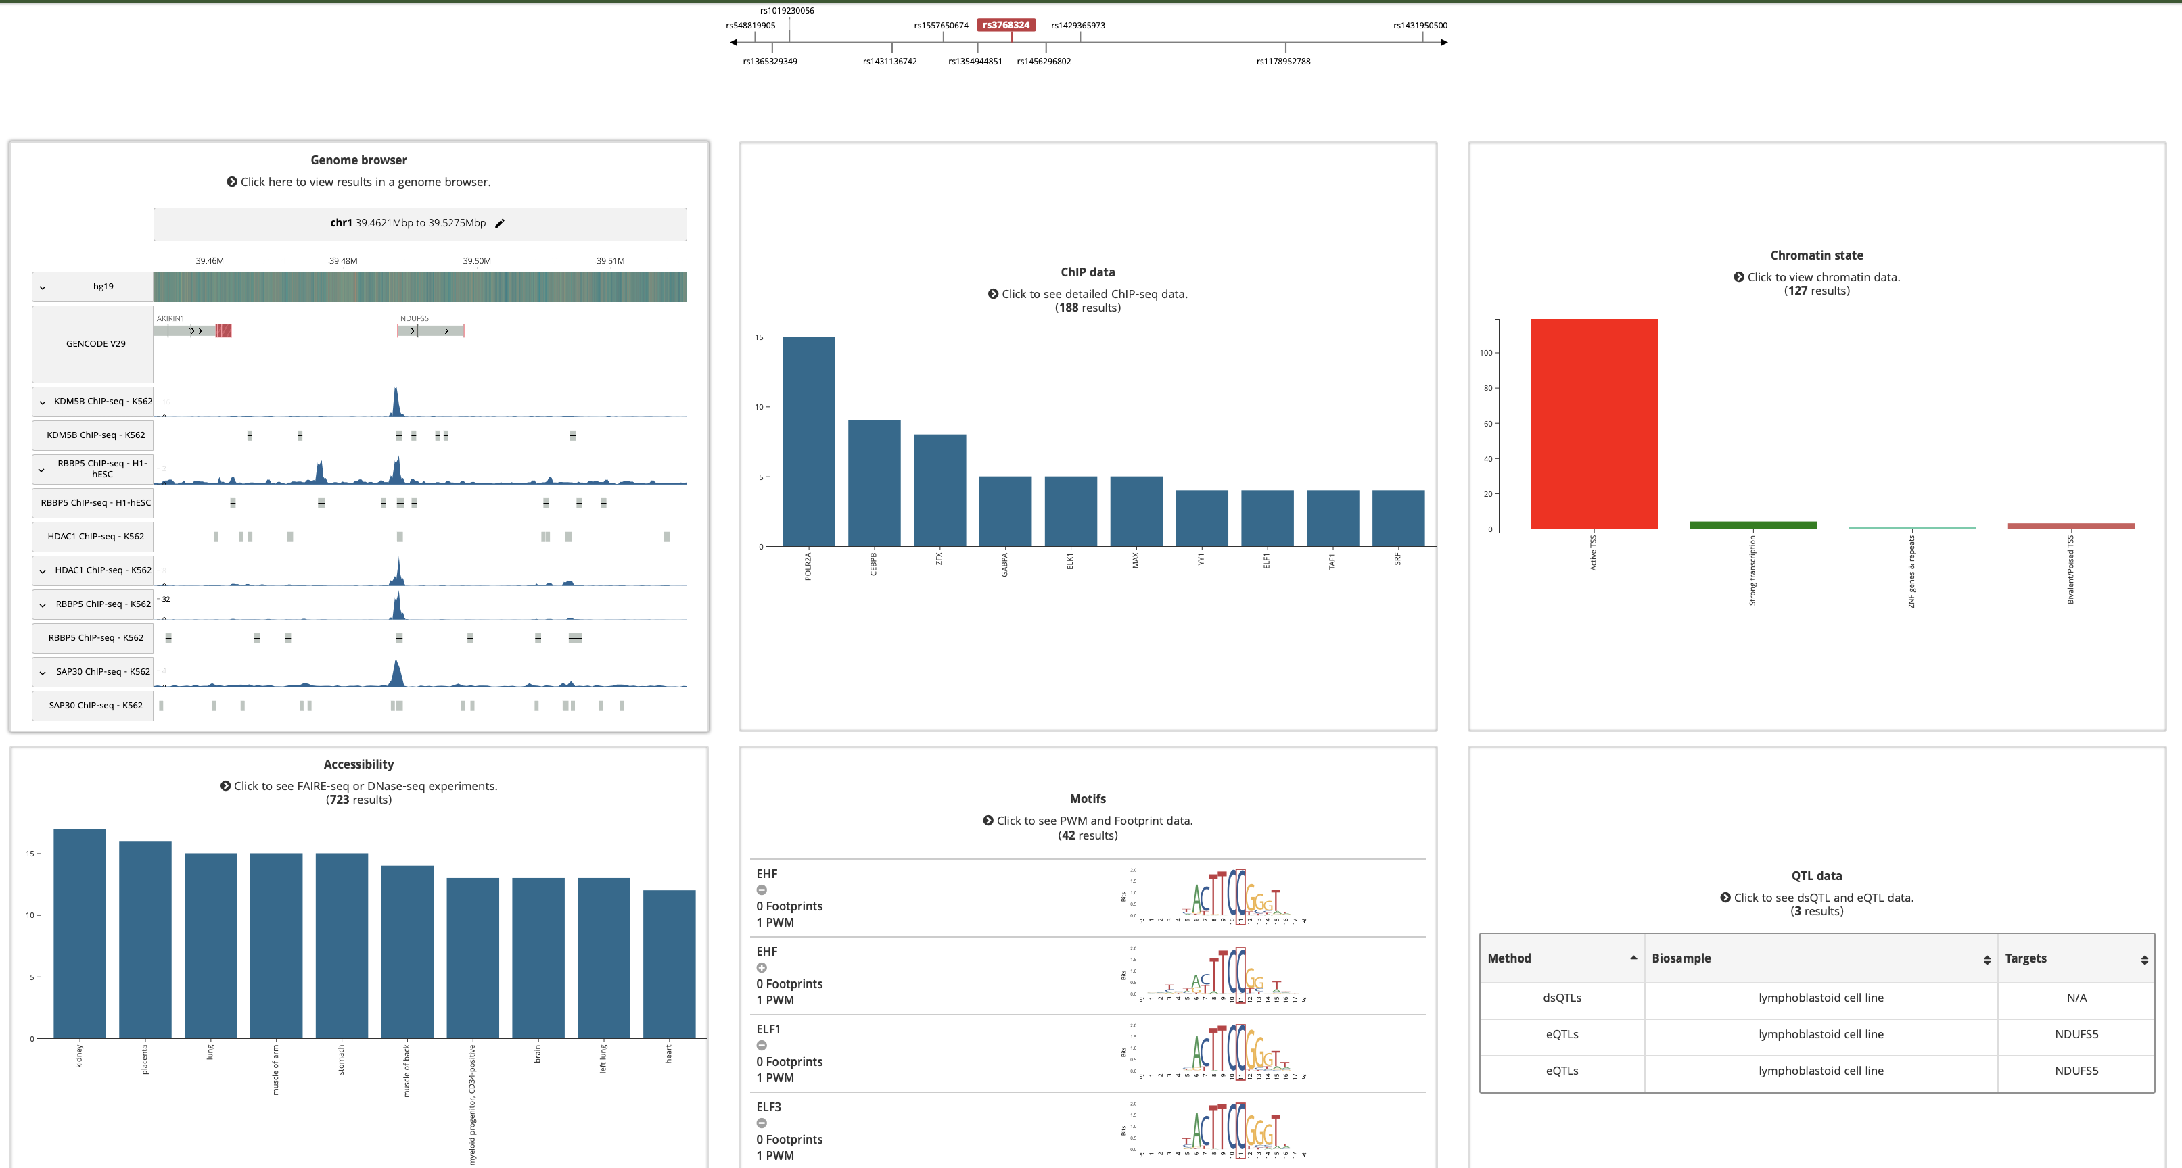
RegulomeDB

Slide 44
“Association-based” annotation methods
Examples of information of interest
Are the loci associated with my trait enriched for…
Expression in a tissue/cell type? At a particular developmental stage?
Particular chromatin markings?
Known regulatory elements for a particular tissue/cell type/stage?
Genes in a network? Pathway? Other categories of genes?
Examples of some enrichment databases/tools
HaploReg
FUMA
A lot of types of gene annotation/gene sets exist

Slide 45
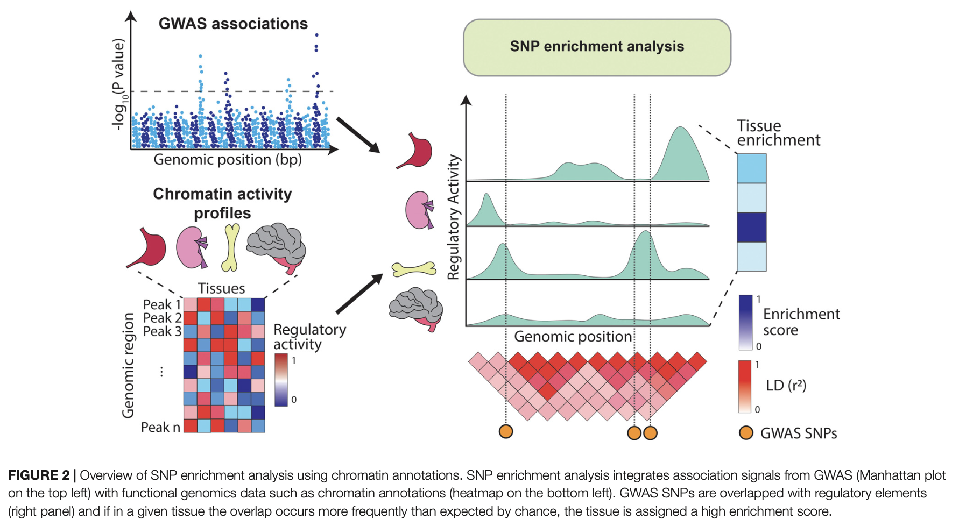
Enrichment – main idea

Slide 46
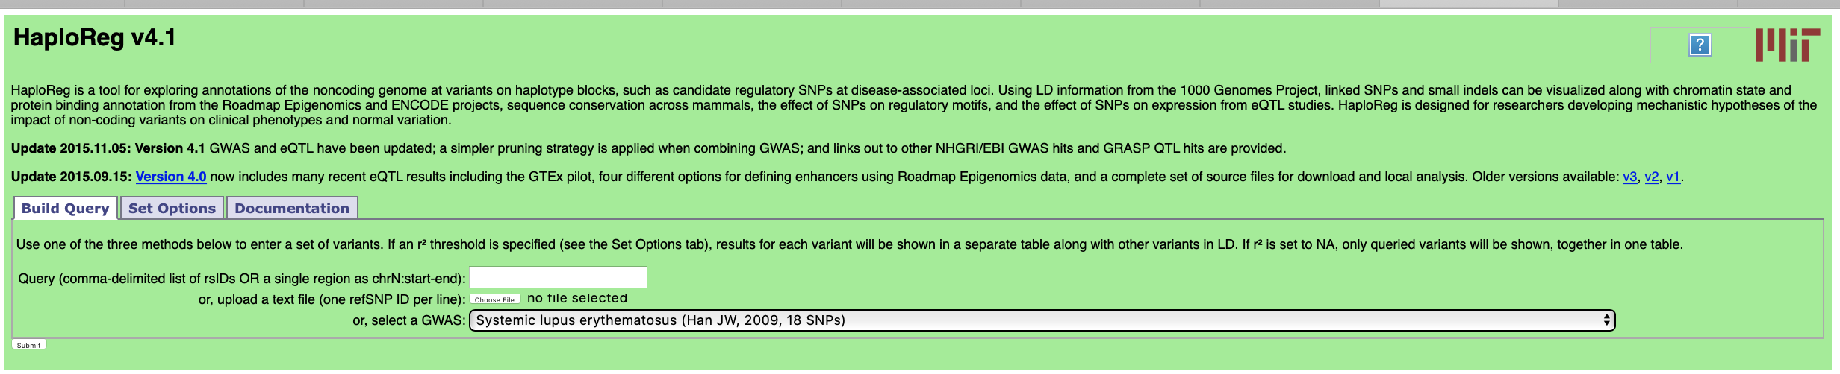
Example: enrichment testing in HaploReg
Are these 18 lupus associations enriched for enhancers in particular cell types?

Slide 47
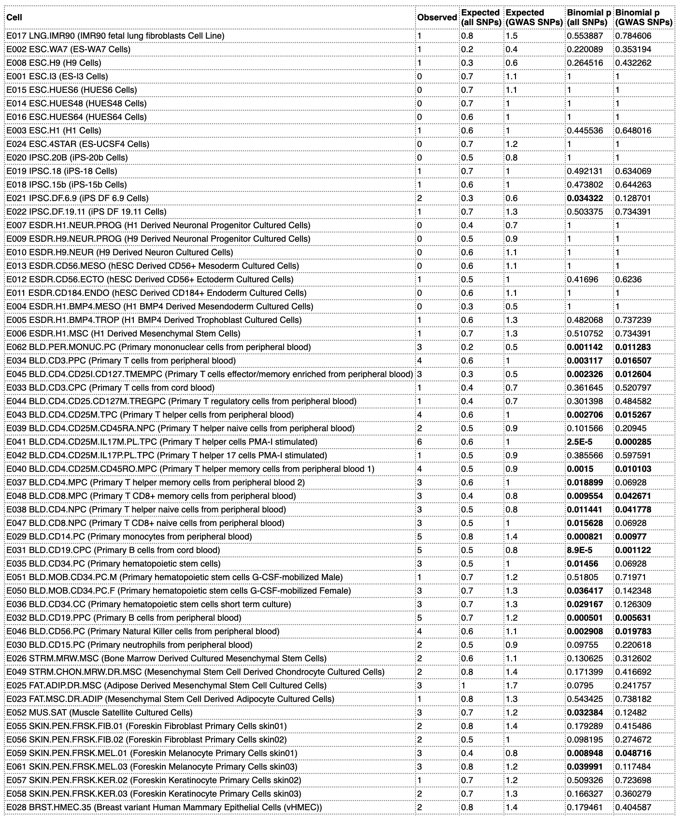
Example: Enrichment testing in HaploReg

Slide 48
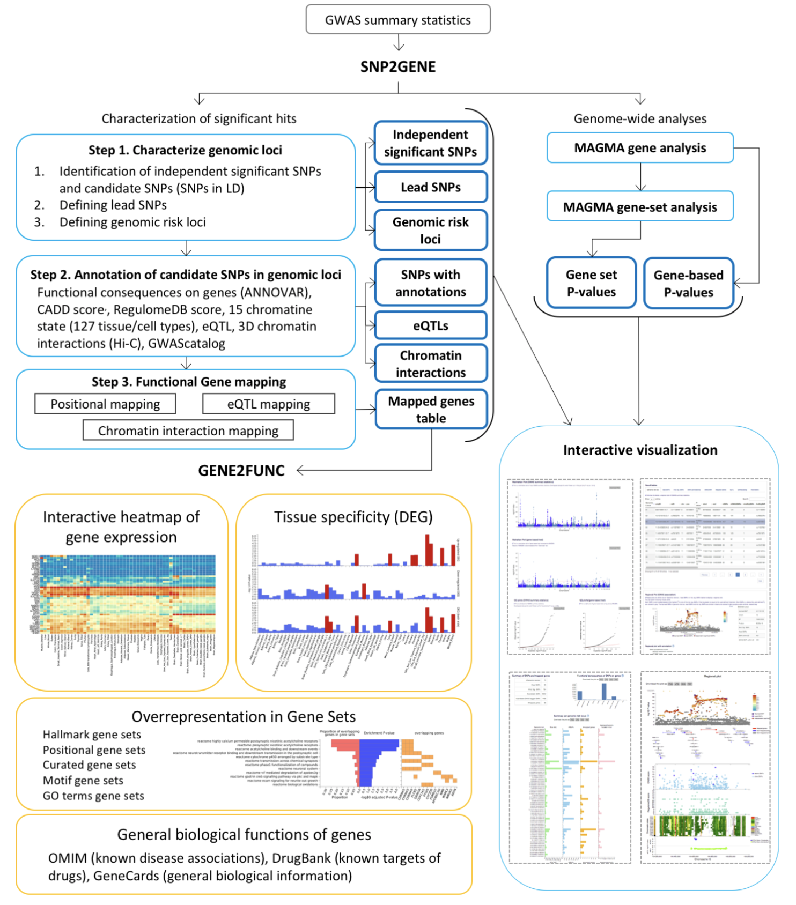
FUMA (Functional Mapping and and Annotation of GWAS)
https://fuma.ctglab.nl
1. Prioritize genes from the various loci
2. Gene enrichment tests, etc.

Slide 49
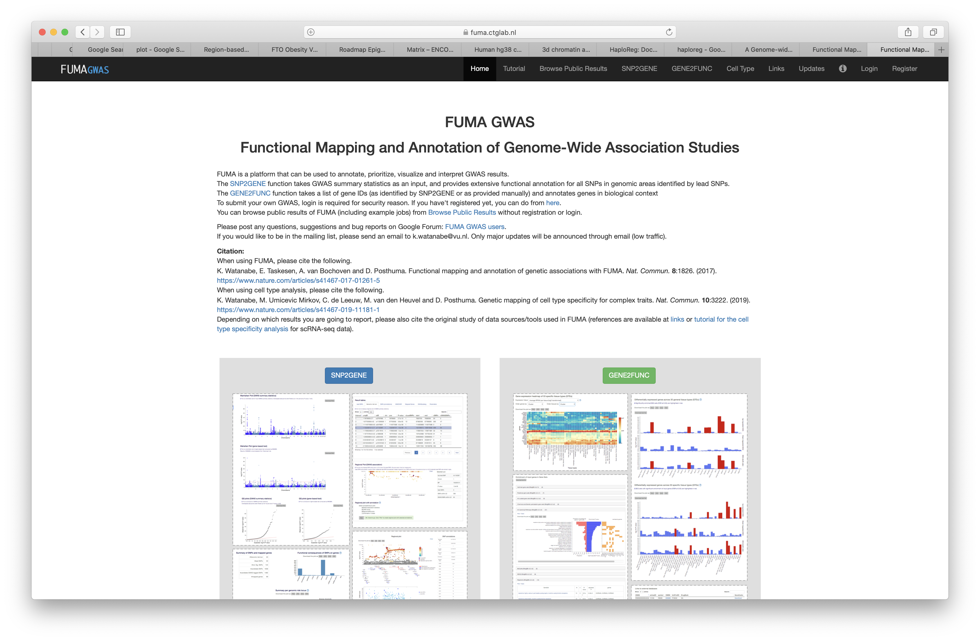
FUMA annotation example

Slide 50
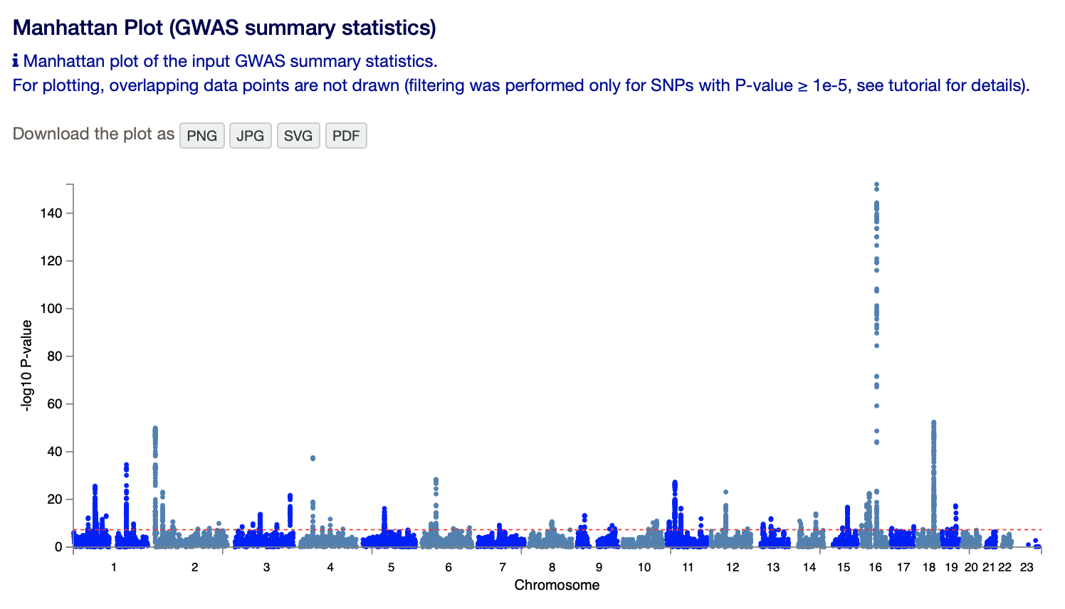
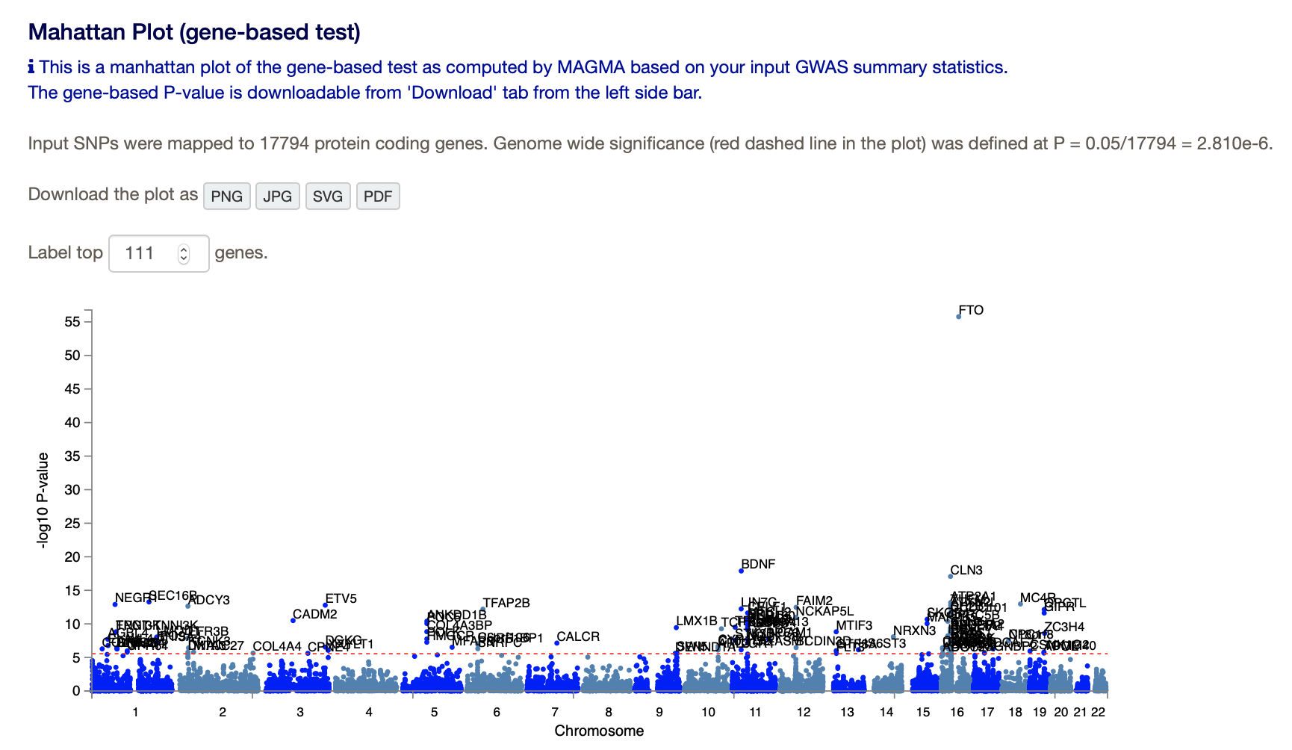
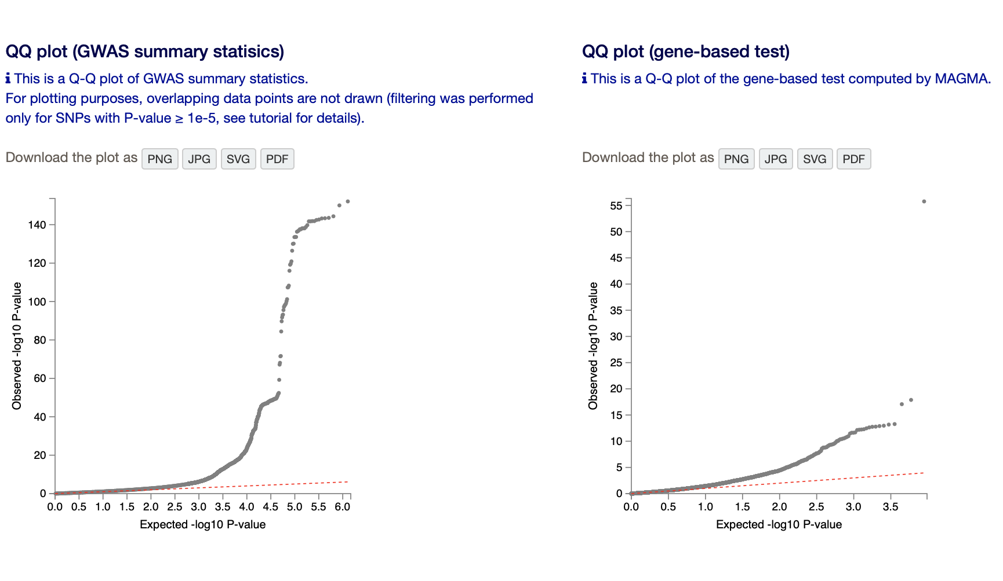
FUMA annotation example

Slide 51
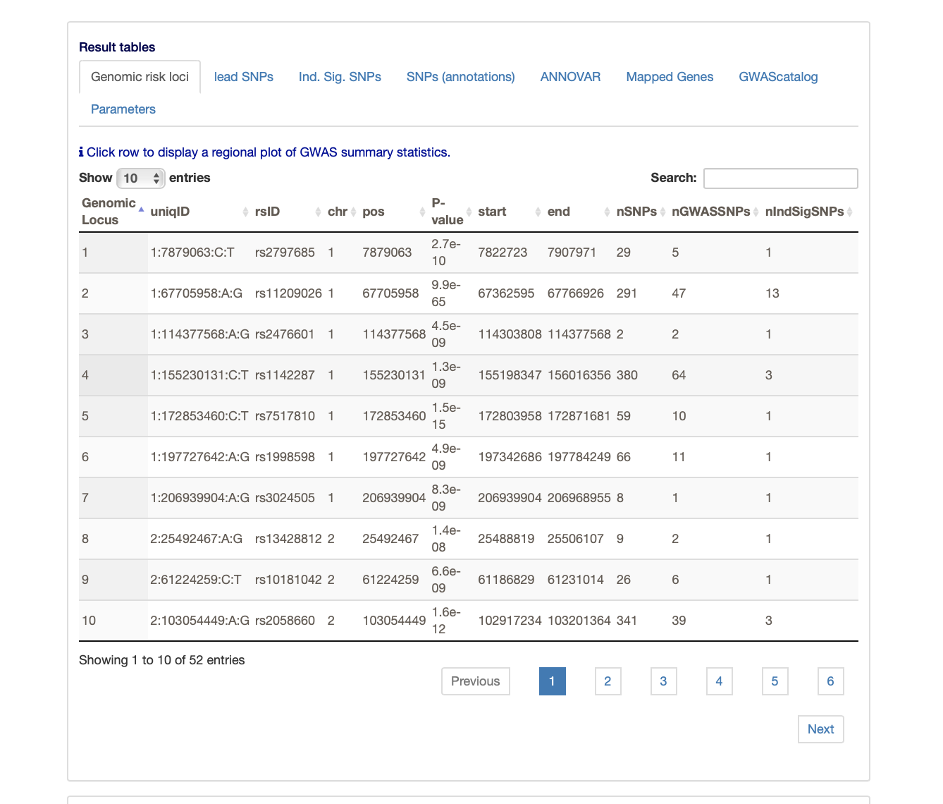
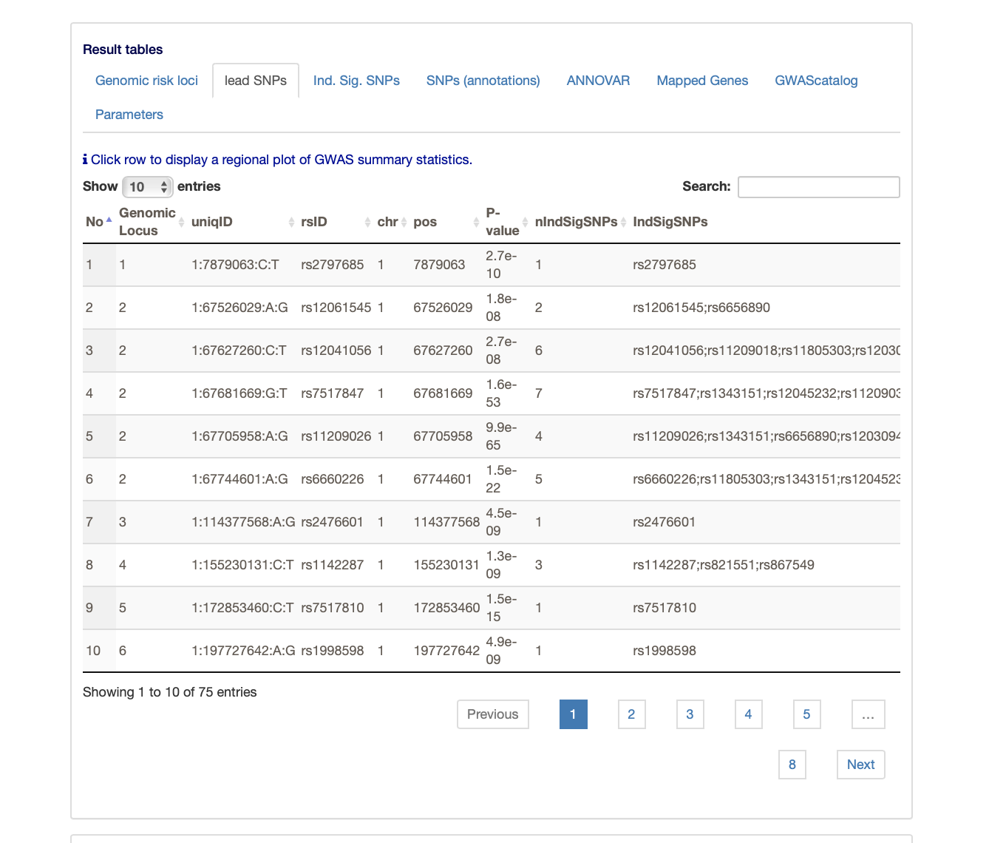
Fuma annotation example
Find the “independent” loci and summarize them
Find the lead SNPs and summarize them

Slide 52
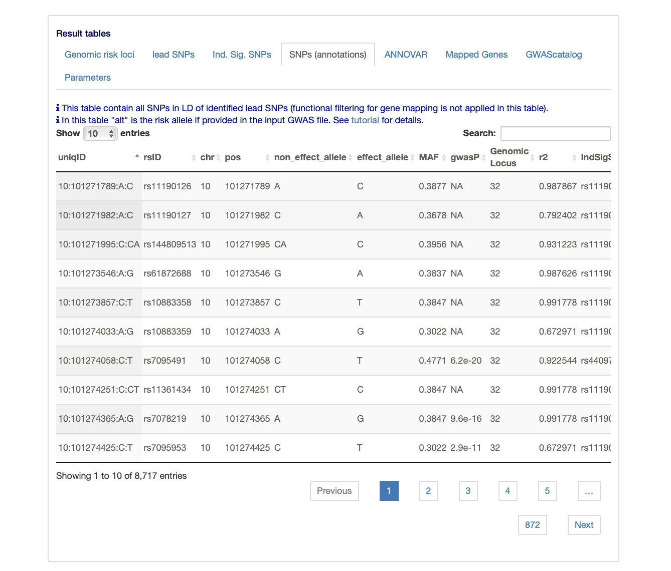
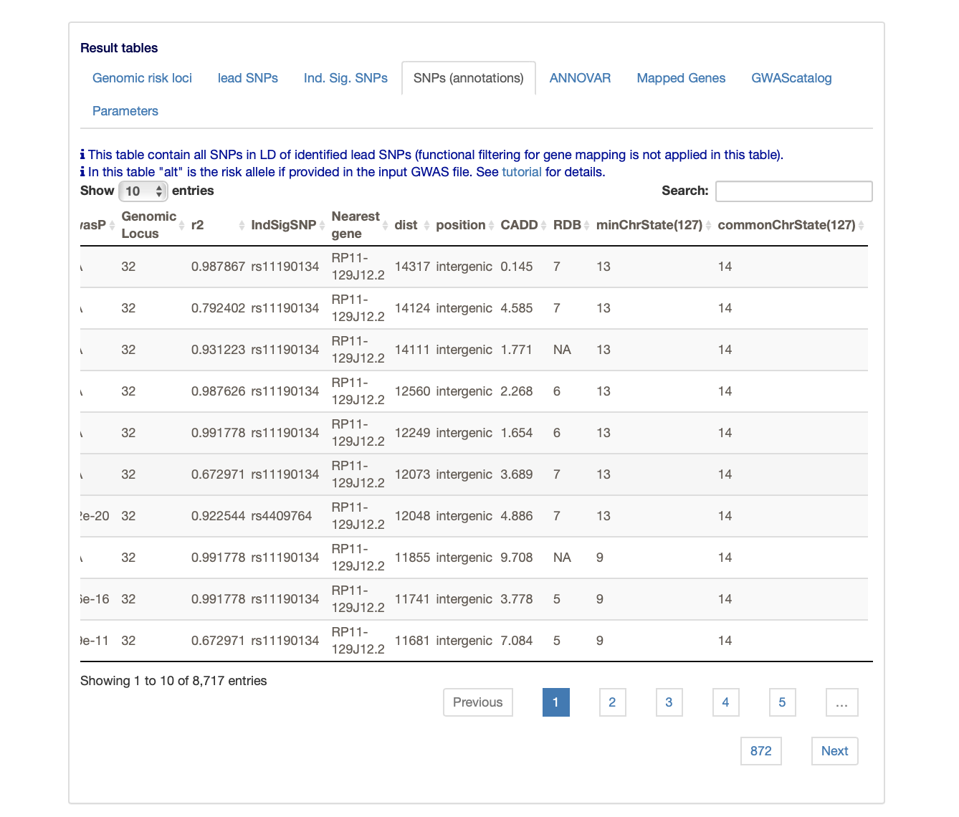
Fuma annotation example
Find SNPs in LD with your associations and merge with annotation

Slide 53
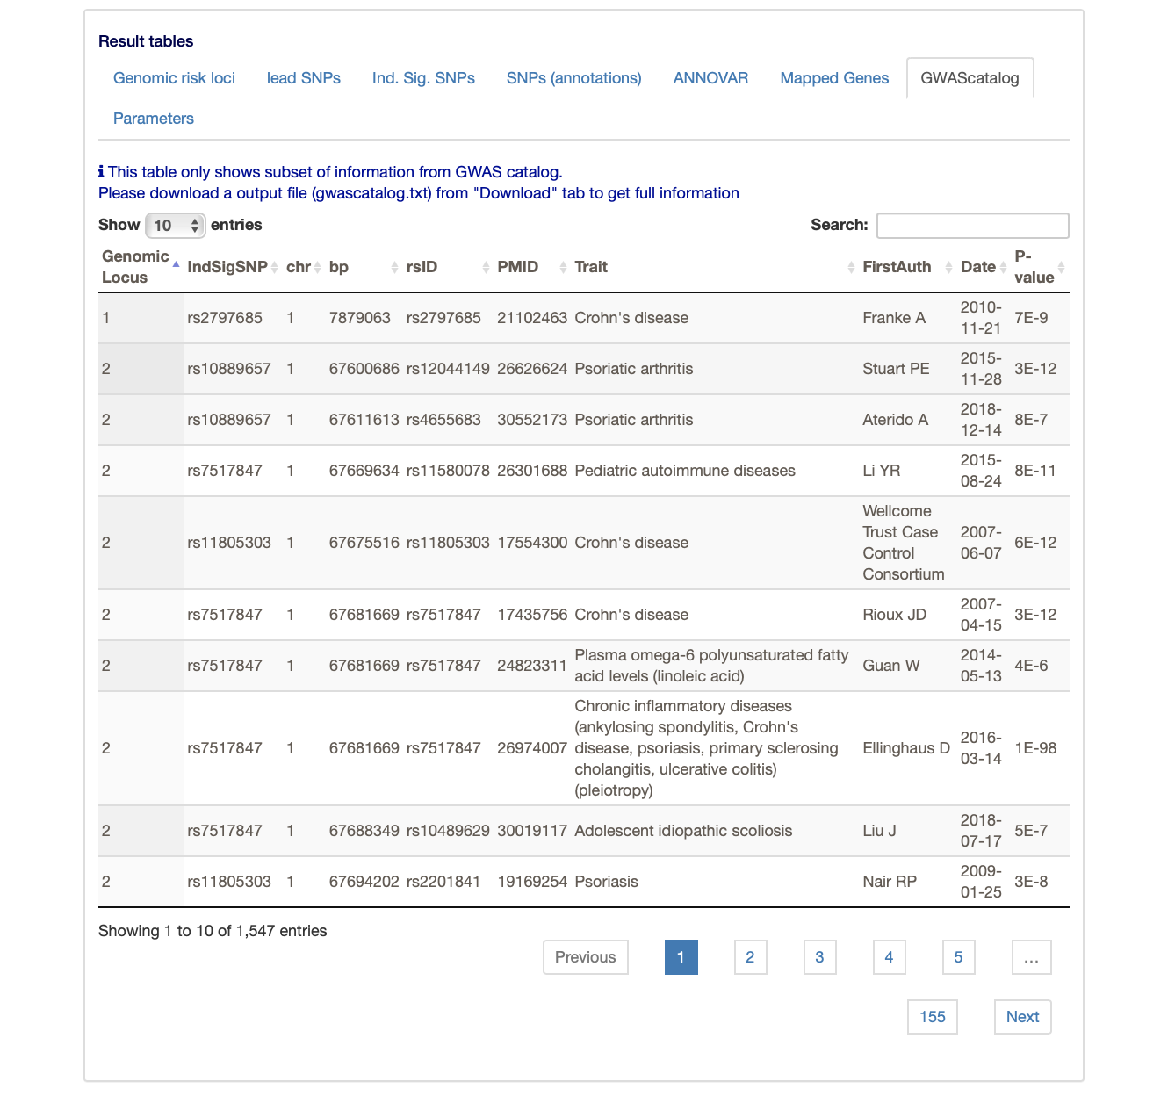
FUMA annotation example
Are your SNPS in GWAScatalog?

Slide 54
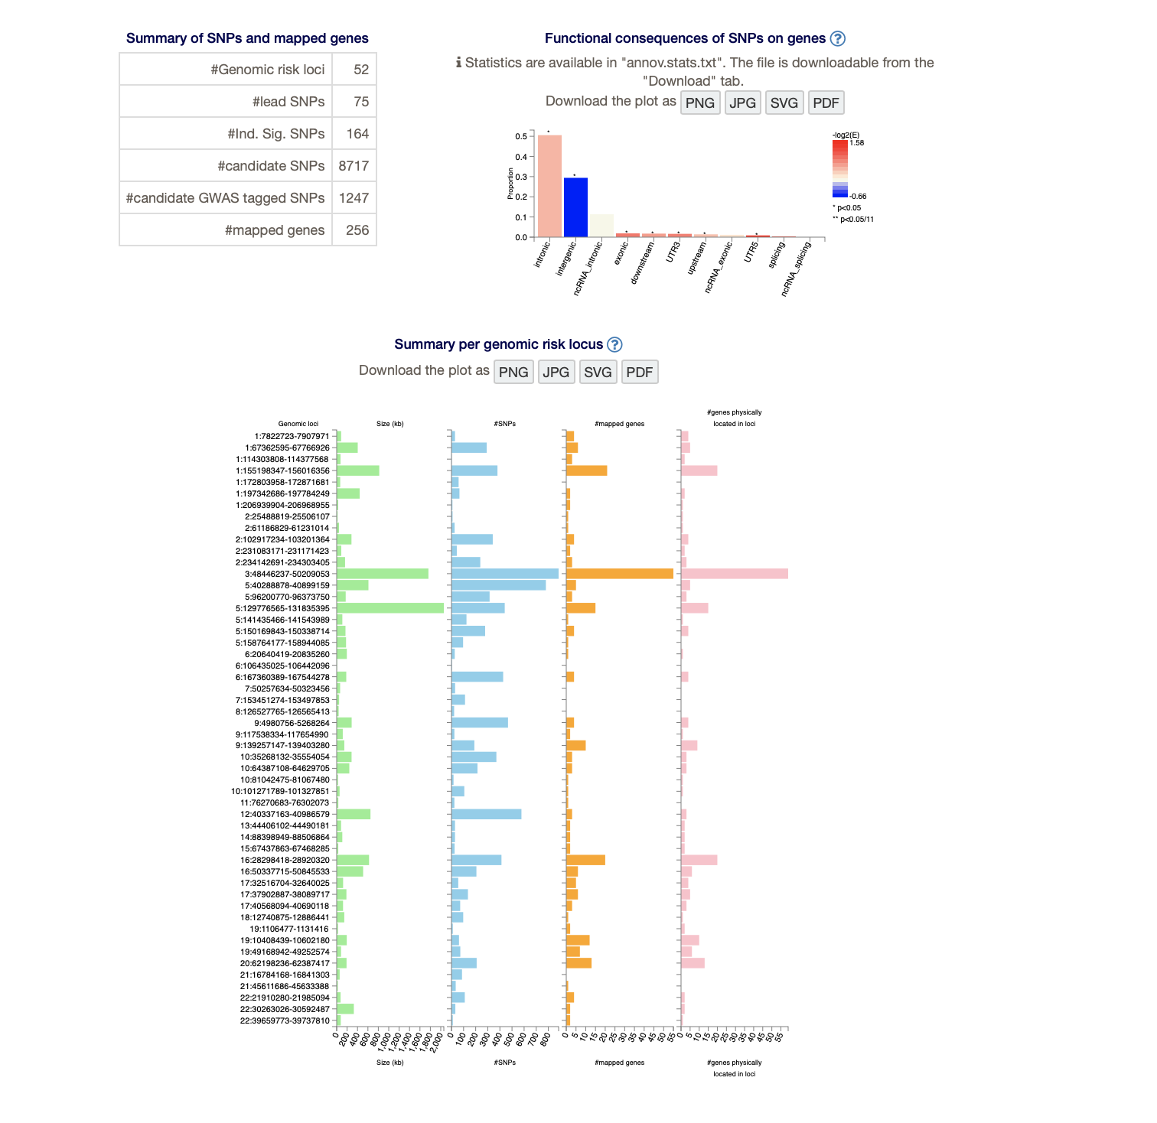
FUMA annotation example

Slide 55
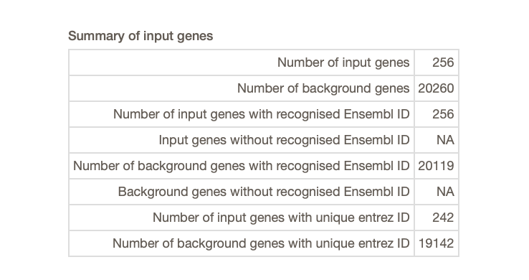
FUMA annotation example
The first step mapped the GWAS associations to a set of genes. The second step analyzes the gene set.

Slide 56
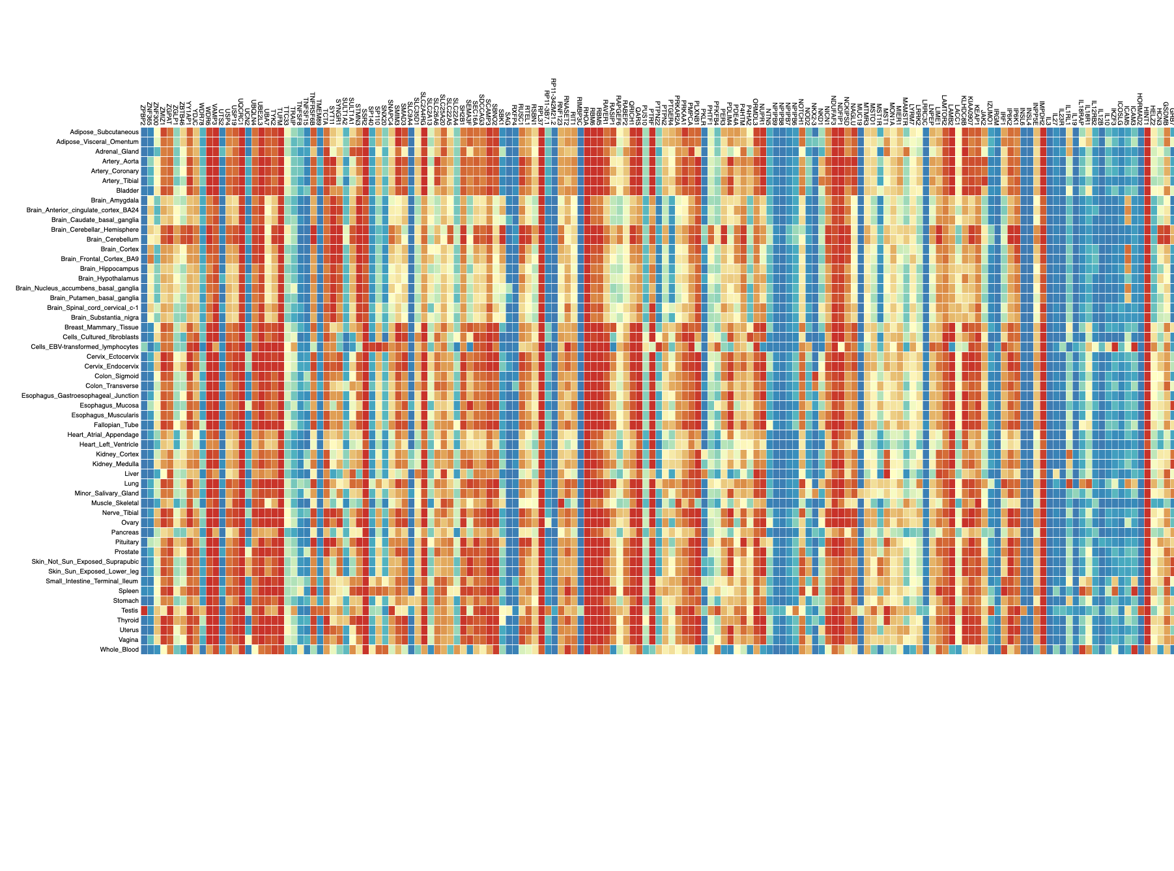
FUMA annotation example
Expression of mapped genes.

Slide 57
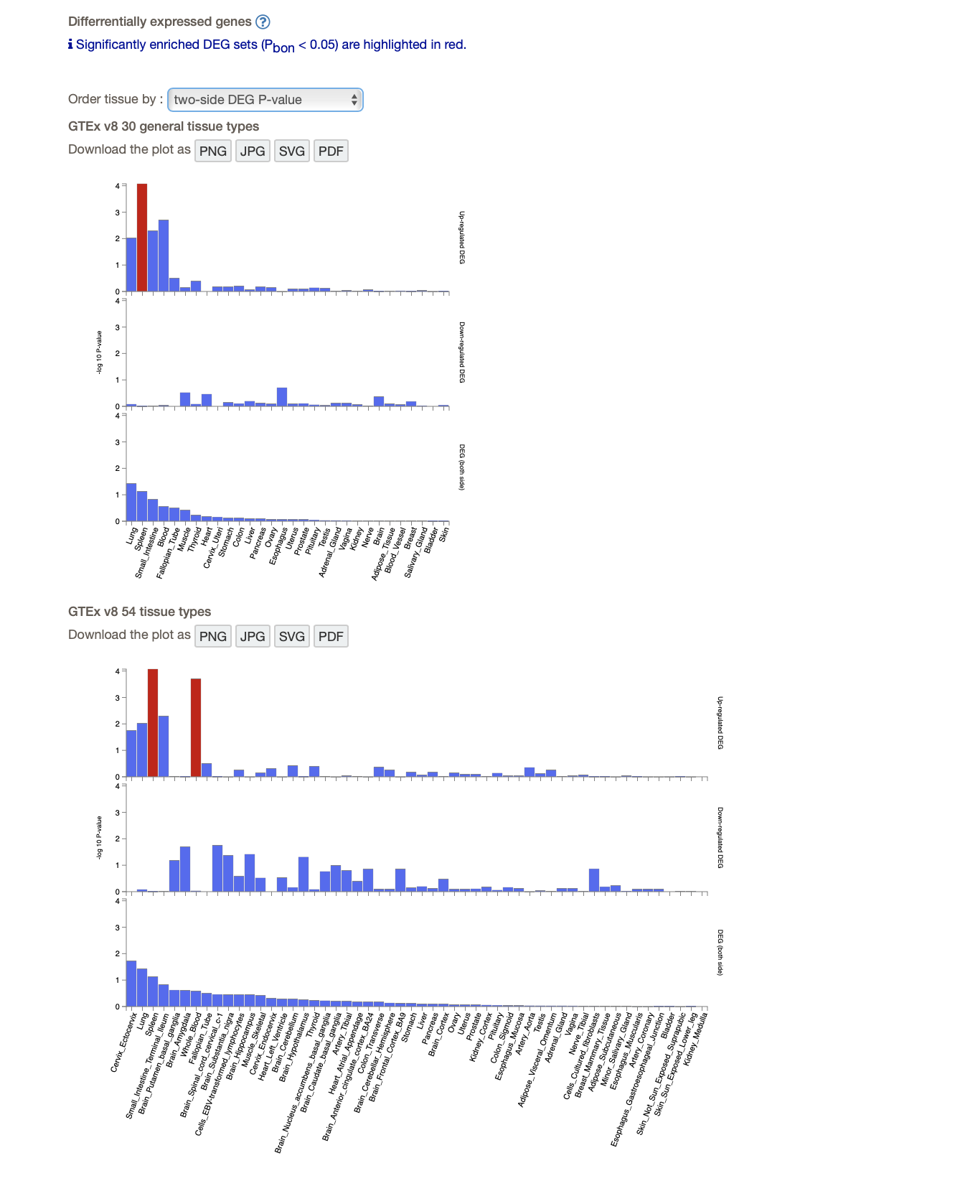
FUMA example
Are the genes enriched for expression in certain tissue types?

Slide 58
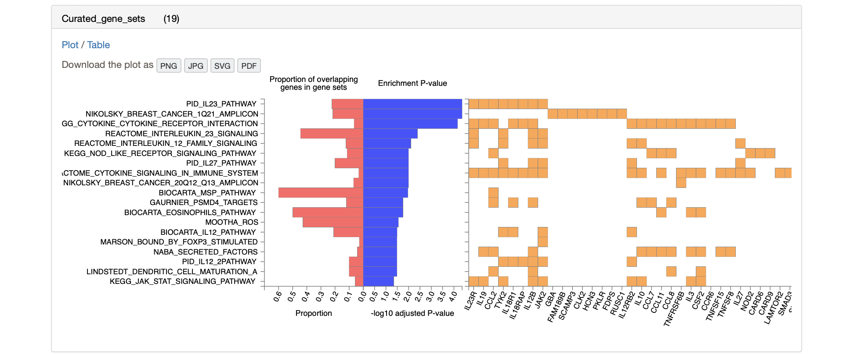
FUMA example
Are the genes enriched for certain pre-defined gene sets?

Slide 59
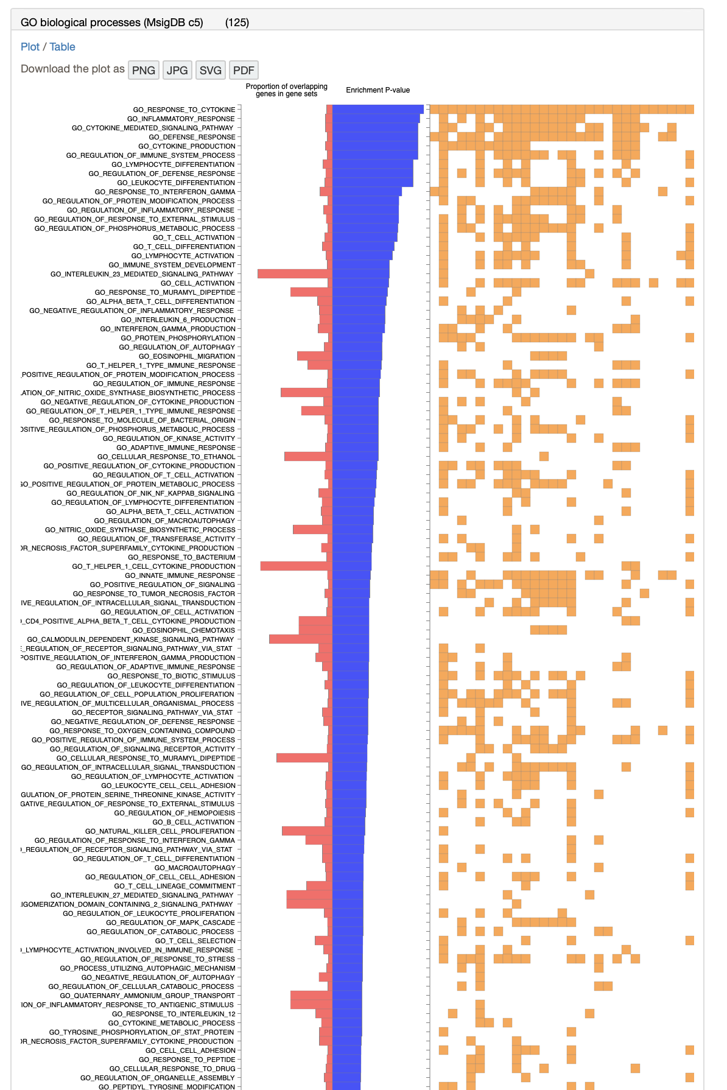
FUMA example
Are the genes enriched for expression in certain tissue types?
(There are a lot of gene sets)

Slide 60
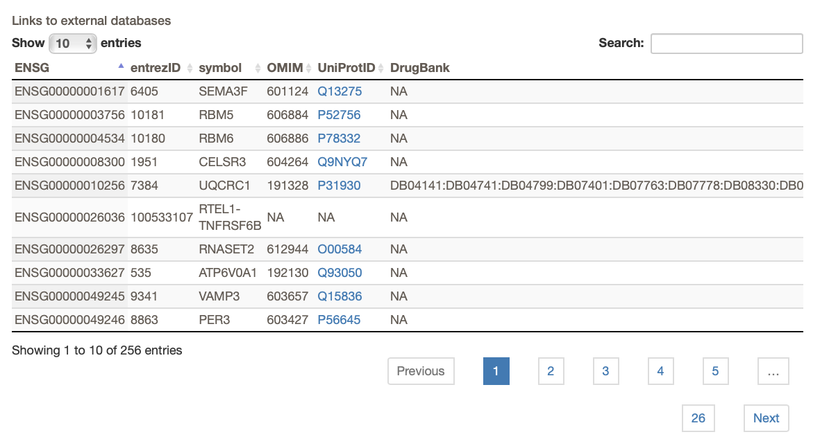
FUMA example
Annotation of the genes (links to gene/protein databases)

Slide 61
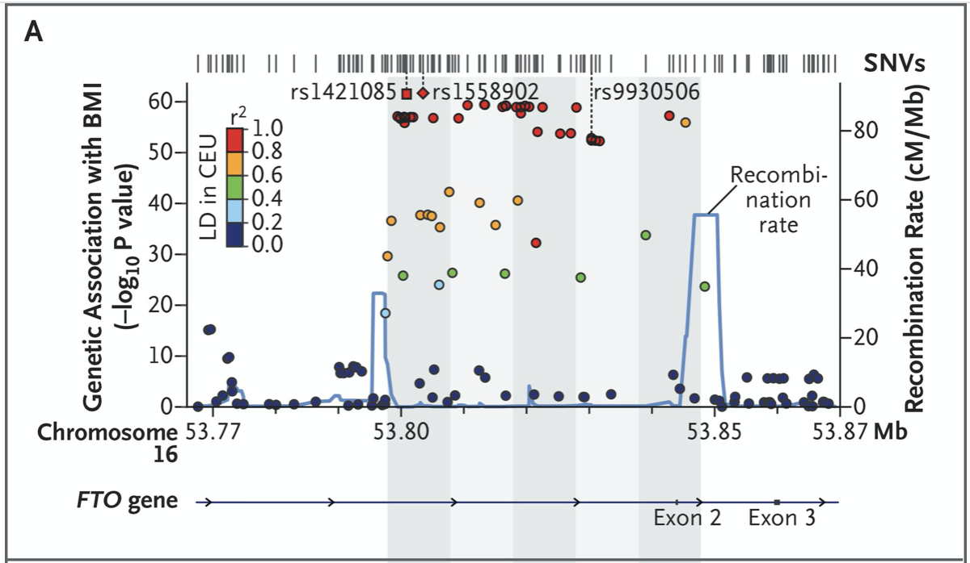
Annotation success story: FTO locus in BMI
Strongest BMI association
Intronic
89 SNPs over 47 kb
Biological significance/mechanism of association was unclear (causal variant, target gene, cell type, pathway, mechanism all unknown)
Claussnitzer, M., Dankel, S. N., Kim, K. H., Quon, G., Meuleman, W., Haugen, C., Glunk, V., Sousa, I. S., Beaudry, J. L., Puviindran, V., Abdennur, N. A., Liu, J., Svensson, P. A., Hsu, Y. H., Drucker, D. J., Mellgren, G., Hui, C. C., Hauner, H., & Kellis, M. (2015). FTO Obesity Variant Circuitry and Adipocyte Browning in Humans. The New England journal of medicine, 373(10), 895–907. https://doi.org/10.1056/NEJMoa1502214
Notes:
Claussnitzer, M., Dankel, S. N., Kim, K. H., Quon, G., Meuleman, W., Haugen, C., Glunk, V., Sousa, I. S., Beaudry, J. L., Puviindran, V., Abdennur, N. A., Liu, J., Svensson, P. A., Hsu, Y. H., Drucker, D. J., Mellgren, G., Hui, C. C., Hauner, H., & Kellis, M. (2015). FTO Obesity Variant Circuitry and Adipocyte Browning in Humans. The New England journal of medicine, 373(10), 895–907. https://doi.org/10.1056/NEJMoa1502214

Slide 62
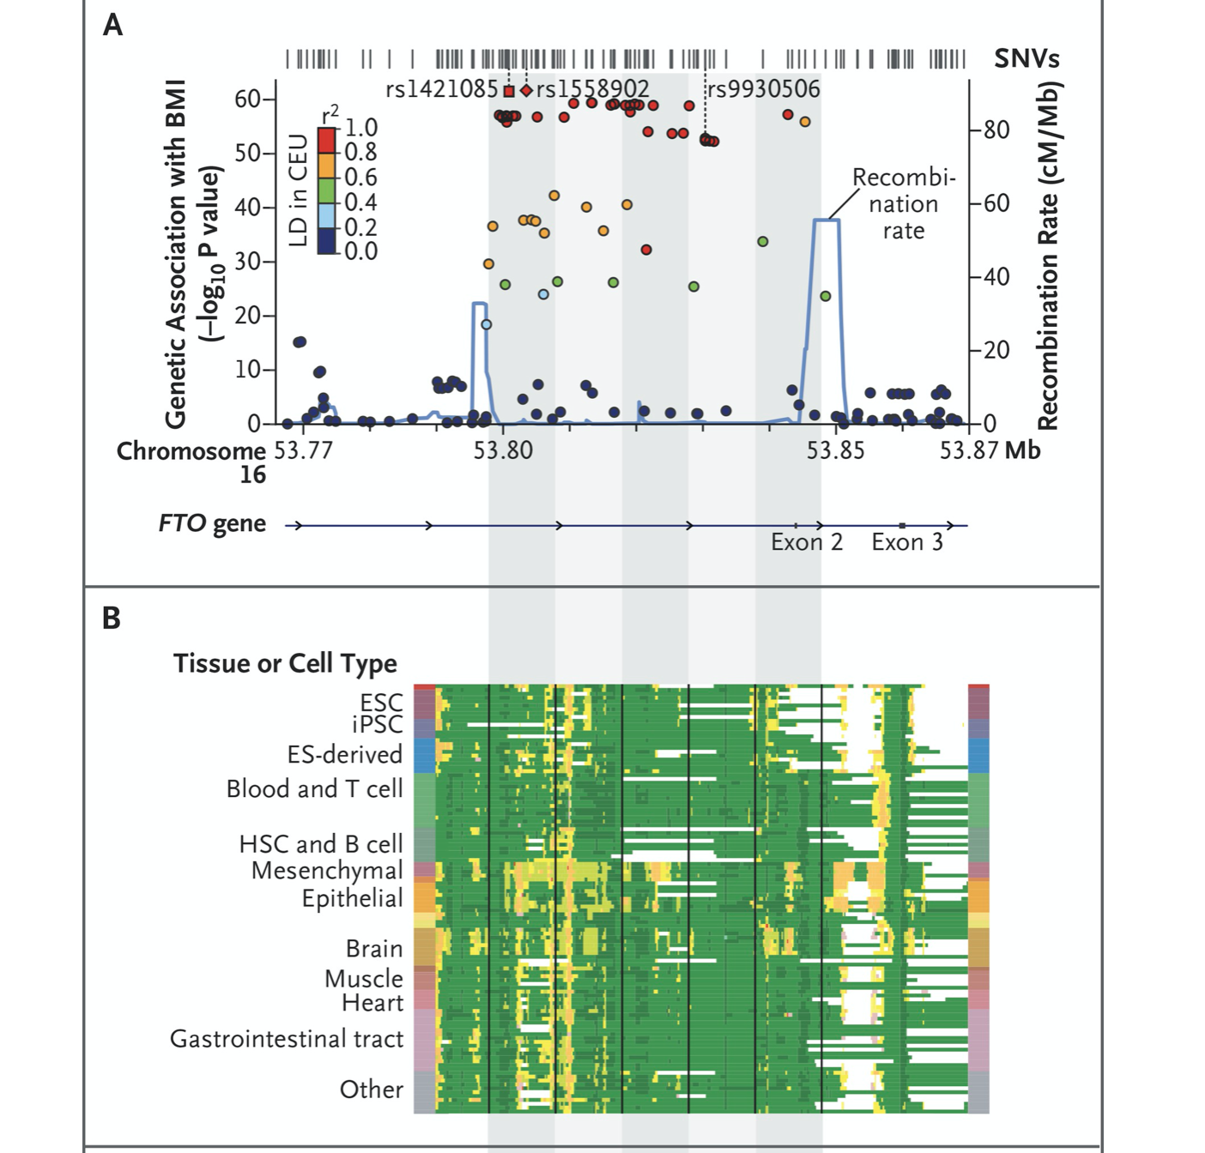
FTO annotation
Look at chromatin state across various cell types
Noticed an “unusually long enhancer (12.8 kb) in mesenchymal adipocyte progenitor indicat[ing]a major regulatory locus ”
(Some earlier “behavioral” hypotheses expected brain tissues to be “the” relevant tissues)

Slide 63


FTO annotation
A ~2 Mb “topological domain” includes 8 genes
(What is a “topological domain”?)
For these 8 genes, is expression associated with genotype at the top SNP?
Yes, for IRX3 and IRX5
Risk allele → higher expression
Effect limited to preadipocytes
Not only cell type but also stage matters

Slide 64

FTO annotation
Why/how does the variant affect IRX3/IRX5 expression?
By altering “T” to “C” in a conserved ARID5B binding motif
ARID5B binding represses transcription of IRX3/IRX5
Disruption of binding → higher expression → phenotype
(Details validated functionally)

Slide 65

FTO annotation
Annotation success
Enhancer information → discover tissue (pre-adipocytes)
Topological information → candidate genes (including IRX3/IRX5)
Motif/conservation information → upstream regulator (ARID5B)
Causal SNP → gene expression → phenotype
What else can we infer about the genes IRX3/IRX5?
What genes are co-expressed with them?
Implicates networks involving energy consumption

Slide 66
Another GWAS story
Many LDL loci are in/near obvious candidates (like Mendelian dyslipidemia genes or established cholesterol target genes)
1p13 locus associated with myocardial infarction and LDL levels
The association was strongest for this locus (p=1E-170)
Same locus linked to coronary artery disease in other studies
Homozygotes for risk (vs protective) alleles have ~40% higher MI risk and 16 higher mg/dl⁻¹ LDL
→ Locus probably affects intermediate phenotype and clinical endpoint
Mechanism unknown
Causal variant at 1p13?
Gene regulated by it?
Regulatory mechanism?
Mechanism of gene action on trait?
Notes:
https://www.nature.com/articles/nature09266

Slide 67
SORT1 (continued)
Authors noted that the locus is associated with a specific class of LDL
Strongest associations are non-coding, between CELSR2 and PRSC1 (functions unknown)
Authors tested whether 1p13 SNPs are cis-regulators of nearby gene expression in liver and other “candidate tissues”
6 strongest SNPs form two haplotypes in people of European descent
A minor allele of rs646776 affects expression of CELSR2, PSRC1 and SORT1 (the latter most); this was replicated

Slide 68
SORT1 (continued)
How to further fine-map?
The candidate region is defined by 6 SNPs in strong LD:
“Together these six best SNPs cluster in a noncoding DNA region that is 6.1 kilobases in size, spanning the 3′ untranslated region (3′UTR) of CELSR2, the intergenic region, and the PSRC1 3′UTR oriented in the opposite direction”
“The six SNPs are in high linkage disequilibrium (LD) and comprise two predominant haplotypes in HapMap Europeans (CEU), with the ‘major’ haplotype present on 68% of chromosomes 1 and the ‘minor’ haplotype on 29%”

Slide 69

SORT1 (continued)
Test which SNP in the block appears to drive gene expression.
rs12740374 seems to the important variant in the haplotype.
Specific to liver (not the two adipose tissue types).
How to further shrink the region?
Use LD from other populations.
“We genotyped rs12740374 and 15 other SNPs in or near the 6.1 kb noncoding region in ∼9,000 African Americans. Whereas six SNPs have indistinguishable evidence for association with LDL-C in Europeans, we found that, in African Americans, rs12740374 alone had the strongest evidence for association (P = 2.3 × 10⁻²⁰for rs12740374 versus 9.2 × 10⁻¹⁵ at the next best 1p13 SNP)”

Slide 70
SORT1 (continued)
Further use of bioinformatics to determine SNP mechanism:
“We observed that rs12740374 alters a predicted binding site for C/EBP transcription factors, with the minor allele creating the site and the major allele disrupting it; the binding site is not present in the orthologous DNA region in mice (Fig. 3a). C/EBPα (also known as CEBPA) is a liver-enriched transcriptional factor that regulates the expression of numerous hepatic genes involved in a variety of metabolic processes”
Further functional validation was done.
Confirmed an rs12740374 allele-specific, tissue-specific change in binding.
Further confirmed that this affects SORT1 expression the most.

Slide 71

Summary

Slide 72


“Risks” of annotation
Biedrzycki, R. J., Sier, A. E., Liu, D., Dreikorn, E. N., & Weeks, D. E. (2019). Spinning convincing stories for both true and false association signals. Genetic epidemiology, 43(4), 356–364. https://doi.org/10.1002/gepi.22189
O = “original” association S = “synthetic” association

Slide 73
Some risks and limitations
Fooling oneself with a “nice story”
Multiple testing problems (e.g., testing hundreds of tissues/cell types)
Failure to “find something” doesn’t prove any null hypothesis about a particular variant or locus (e.g., maybe no one has studied the right gene/tissue/cell at the right time/under the right conditions)

